Slide 1
Clackamas county and the pathway to suicide safer care
Prepared for the Quarterly Managers Meeting
3.16.17

Slide 2

before we begin . . .

Slide 3
Clackamas county and suicide safer care
If you have comments, questions, feedback, criticism or suggestions please use the note card, write it down and leave it on the table on your way out.
All of what you are thinking is welcome here.
Your honesty is our most valuable asset in this process.

Slide 4
National Suicide statistics
Suicide is the 10th leading cause of death in the US
For every death by suicide, 25 attempts occur
Annual age-adjusted suicide rate is 13.26 per 100,000 individuals (2015) and continues to go up.
Men die by suicide 3.5x more often than women.
On average, there are 121 suicides per day.
White males accounted for 7 of 10 suicides in 2015.
Firearms account for almost 50% of all suicides.
The rate of suicide is highest in middle age — white men in particular.
American Foundation For Suicide Prevention, https://afsp.org/about-suicide/suicide-statistics/

Slide 5
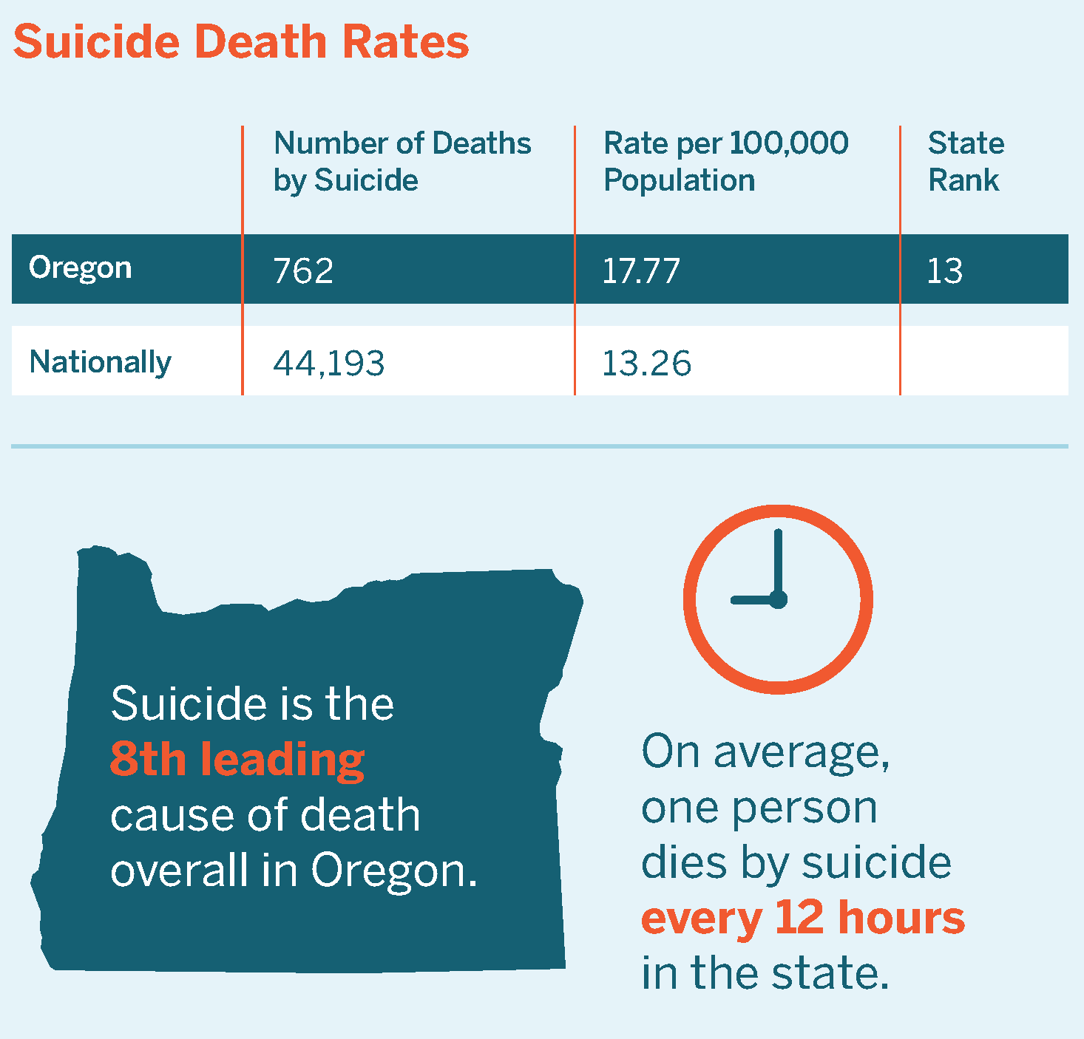
Oregon suicide statistics
Higher than the national average for the past 3 decades.
Suicide is the 2nd leading cause of death among Oregonians aged 15 to 34 years of age, and the 8thleading cause of death among all ages in Oregon.
More than 2,000 hospitalizations are due to self-harm or suicide attempts in Oregon each year.
Firearms accounted for 55% of deaths.
Oregon Health Authority http://geo.maps.arcgis.com/apps/MapSeries/index.html?appid=9c59be59ef7142dfad40d95e3b36f588
American Foundation for Suicide Prevention https://afsp.org/about-suicide/suicide-statistics/

Slide 6
Clackamas county statistics
As of 2015, Clackamas County now has a higher rate than Washington and Multnomah counties with a 17.4 suicide death rate per 100,000 (Oregon Health Authority, 2015)
Our County has a 16% higher rate of suicide than that of the national rate.
1 death by suicide every 5 days in our County
On average, 52 people a year die of suicide.
Oregon Suicide Dashboard, https://public.tableau.com/profile/oregon.injury.and.violence.prevention#!/vizhome/ORVDRSDashboardDraftJan2017/TableofContents

Slide 7
2015-2016 Clackamas County Deaths from Suicide
Notes:
14.8% decrease in deaths from suicide from 2015 to 2016. However, still more than 1 suicide death per week
2014 deaths = 62

Slide 8
2015-2016 Deaths from Suicide: Gender
Notes:
For 2015 & 2016, males accounted for 81% of suicide deaths in Clackamas County

Slide 9
2015-2016 Clackamas County Deaths from Suicide: Gender and Age
Notes:
Individuals between 41 and 55 accounted for the majority of suicide deaths for 2015 & 2016
Females tend to skew slightly older (41-55 and 56-70 highest number of deaths) compared to males (25-40 & 41-55 highest number of deaths).

Slide 10
2015-2016 Clackamas County Deaths from Suicide: Cause of Death
Notes:
Firearms account for 53.3% of cause of death for suicide deaths in 2015 & 2016
Hanging – 21.2%
Overdose – 9.5%
Blunt Force Trauma – 5.1%
These 4 methods account for nearly 90% of suicide deaths for 2015 & 2016

Slide 11
2017 Clackamas County Deaths from Suicide
11 deaths as of 3/8/2017
  2 Females
  9 Males
  Age range: 26-74 years
Cause of Death
  4 Firearms
  2 Overdose
  1 Hanging
  1 Poisoning
  1 Asphyxia
  1 Stab Wound
  1 Burns + Smoke Inhalation

Slide 12
We know who is at risk . . .
Mental or emotional disorders, particularly depression and bipolar disorder
• Previous suicide attempts or self-inflicted injury
• History of trauma or loss, such as abuse as a child, family history of suicide,
bereavement, economic loss
• Serious illness, or physical or chronic pain or impairment
• Alcohol and drug abuse
• Social isolation or a pattern/history of aggressive or antisocial behavior
• Discharge from inpatient psychiatric care within the first year after, and
particularly within the first weeks and months after discharge
• Access to lethal means coupled with suicidal thoughts

Slide 13
. . . we know h3s serves these individuals
8 categories/groups/populations identified by most (at least 4 of 6) or all Divisions via H3S Zero Suicide Implementation Team:
Individuals experiencing homelessness or individuals at risk for becoming homeless
Individuals with diagnosed or undiagnosed mental health and addictions issues
Veterans
Individuals living in poverty/unemployed
Seniors/elderly
Youth
Individuals experiencing or who have experienced abuse/domestic violence
Individuals dealing with illness (chronic, communicable, etc.) and/or disability

Slide 14
we also know that . . .
In the month before their death by suicide:
Half saw a primary care provider
30% saw a mental health professional
Risk of suicide is highest in the first 30 days following discharge from:
An emergency department
An inpatient psychiatric unit
Zero Suicide, zerosuicide.sprc.org

Slide 15
We also know that . . .
Over the past decade, the national suicide rate has increased.
In 2003 = 10.8
In 2013 = 12.6
In 2015 = 13.26
And we are still not talking about it.

Slide 16
Let’s start the conversation
What is our approach to caring for and tracking individuals at risk for suicide?
It’s time to look at it differently.

Slide 17
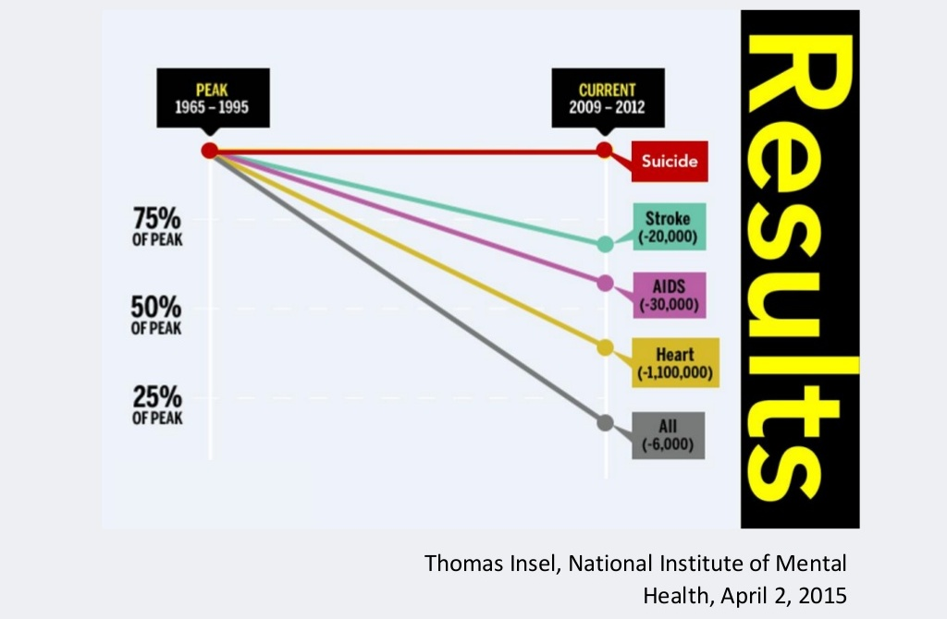
If they can do it so can we
History has shown that action by organizations can, eventually, make a large and life saving difference, even for issues that at first seem impossible.
Stroke, AIDS, Heart disease have dropped dramatically.
Not for suicide. Not yet.
Notes:
In the last 60 years tremendous strides have been made in the fight against cancer, polio, smallpox and other diseases. For polio, getting rates down meant a global effort to immunize every human being. For cancer it meant more research, better screening and aggressive therapies. In the case of suicide, it means setting a goal of zero deaths.

Slide 18
What if we changed our approach?
Attempting to reduce suicides for people in our care to zero may seem scary or even impossible but what other number should we strive for?
What if we shifted our perspective that 52 deaths is too many and that zero was the only acceptable number?

Slide 19
Zero Suicide: A Shift in our Perspective
Zero Suicide is a commitment to suicide prevention in health, behavioral health care and other systems.
Shift from stand alone training & tools to overall system and culture change.
Shift from individual judgment & actions to standardized screening, assessment, risk stratification, and intervention.
Develop intentional pathways to care for suicidal individuals not unlike an intentional pathway for someone with diabetes.
A commitment to reduce suicide deaths and provide suicide safer care in those we serve.
Notes:
What type of formal commitment have we made to reduce suicide and provide safer suicide care among people who use the organization’s services?

Slide 20
Video: An introduction to zero suicide
Notes:
https://youtu.be/tYmRtILWqAE

Slide 21
This is a shift in how we have historically done our work
Instead of thinking, “What does this work have to do with my division?”
Start asking yourself, in what ways can my division be intentional about providing suicide safer care?

Slide 22
the momentum continues
Clackamas County H3S has committed to suicide safer care.
Over 500 staff in our H3S workforce have been trained in MHFA.
Each Division has a representative at the larger H3S Zero Suicide Implementation Team. They are intended to be a conduit.
The team meets monthly and will ultimately provide recommendations to H3S Leadership as to how to operationalize this initiative across the Department.
Health Centers and Behavioral Health Divisions also have Zero Suicide Implementation Teams that meet regularly and will provide recommendations to their Division Leadership.

Slide 23
What are our next steps?
Get in touch with your H3S Zero Suicide Implementation Team representative. They are your conduit of information.
We have created Zero Suicide Goalposts to better define how to be intentional and how to stay in alignment as a Department. More conversation to come.
The work of suicide prevention is no longer the responsibility of behavioral health workers. This work belongs to all of us.
We can—and we are—changing the future of suicide prevention and suicide care for those we serve.

Slide 24
Zero is the only acceptable number
“It is critically important to design for zero even when it may not be theoretically possible…It’s about purposefully aiming for a higher level of performance.”
Thomas Priselac, President and CEO of Cedars-Sinai Medical Center

