Slide 1
Zero Suicide Initiative
A commitment to suicide prevention in health care and behavioral healthcare settings

Slide 2
What is Zero Suicide?
Zero suicide is a key concept of the 2012 National Strategy for Suicide Prevention, a priority of the National Action Alliance for Suicide Prevention, a promoted project through SPRC, and supported by the Substance Abuse and Mental Health Services Administration (SAMHSA)
Zero Suicide is a foundational belief that suicide deaths for individuals under care within health and behavioral health care systems are preventable.
Within health care systems, the Zero Suicide approach represents a commitment to:
-To patient safety, the most fundamental responsibility of health care
-To the safety and support of clinical staff, who do the demanding work of treating and supporting suicidal patients

Slide 3
2012 National Strategy for Suicide Prevention: GOALS AND OBJECTIVES FOR ACTIONS a report of the U.S. Surgeon General and of the National Action Alliance for Suicide Prevention
Goal 8: Promote suicide prevention as a core component of health care services.
Goal 9: Promote and implement effective clinical and professional practices for assessing and treating those at risk for suicidal attempts and behaviors
Garrett Lee Smith Youth Suicide Prevention Grant Goals:
Goal 6: Comprehensively implement sections of the 2012 National Strategy for Suicide Prevention to reduce rates of suicidal ideation, attempts, and deaths in local communities

Slide 4
7 Essential Elements of Suicide Care (as identified by the Action Alliance’s Clinical Care and Intervention Task Force)
LEAD: Create a leadership-driven, safety-oriented culture committed to dramatically reducing suicide among people under care.
TRAIN: Develop a competent, confident, and caring workforce.
IDENTIFY: Systematically identify and assess suicide risk among people receiving care
ENGAGE: Ensure every person has a suicide care management plan or pathway to care that meets the client’s needs. This includes safety planning and lethal means restriction.
TREAT: Use effective, evidence-based treatments that directly target suicidality.
TRANSITION: Provide continued contact and support, especially after acute care.
IMPROVE: Apply a data-driven quality improvement approach to inform system changes that will lead to improved patient outcomes and better care for those at risk.

Slide 5
How do we Lead and Train?
LEAD
Engage Leadership, CEO’s, decision makers, funders, and supporting committees within agencies willing to support Zero Suicide
Review safety standards of each organizations to see how zero suicide could fit in to an organization
Include suicide attempts and loss survivors in leadership and planning roles
Find a “champion” at each organization to help promote and implement
Train
Promote, implement, host, and assist in organization of best practice trainings with organizations willing to adopt Zero Suicide
AMSR
C.A.L.M.

Slide 6
How do we Identify and Engage?
Identification happens when an agency is able to systemically identify and assess suicide risk among people receiving care. This includes consistently using best practice screening tools to assess and manage suicide risk.
Engagement happens when an agency is willing to ensure that every client has a suicide care management plan or a pathway to care that is timely and adequate to meet the client’s needs. This includes collaborative safety planning and restrictions to lethal means.

Slide 7
Columbia-Suicide Severity Rating Scale
SUICIDE IDEATION DEFINITIONS AND PROMPTS
Ask questions that are bolded and underlined.
Ask Questions 1 and 2
1) Wish to be Dead: Person endorses thoughts about a wish to be dead or not alive anymore, or wish to fall asleep and not wake up. Have you wished you were dead or wished you could go to sleep and not wake up?
2) Suicidal Thoughts: General non-specific thoughts of wanting to end one’s life/commit suicide, “I’ve thought about killing myself” without general thoughts of ways to kill oneself/associated methods, intent, or plan. Have you actually had any thoughts of killing yourself?
If YES to 2, ask questions 3, 4, 5, and 6. If NO to 2, go directly to question 6.
3) Suicidal Thoughts with Method (without Specific Plan or Intent to Act): Person endorses thoughts of suicide and has thought of a least one method during the assessment period. This is different than a specific plan with time, place or method details worked out. “I thought about taking an overdose but I never made a specific plan as to when where or how I would actually do it….and I would never go through with it.” Have you been thinking about how you might kill yourself?
Some Healthcare systems have worked to automatically link the EHR to C-SSRS.
"It's a forced choice. You cannot sign and complete the EHR until you have also done the C-SSRS."
The C-SSRS also is activated whenever a red flag is raised in the provision of care, such as a trauma patient talking about escalated drinking and negative thinking.
Dr. McCall, Chairman of the Dept. of Psychiatry and Health Behavior at the Medical College of Georgia at Georgia Regents University
Identify
Notes:
Example of an assessment tool. C-SSRS is gaining a lot of traction nationally and is a free tool.

Slide 8
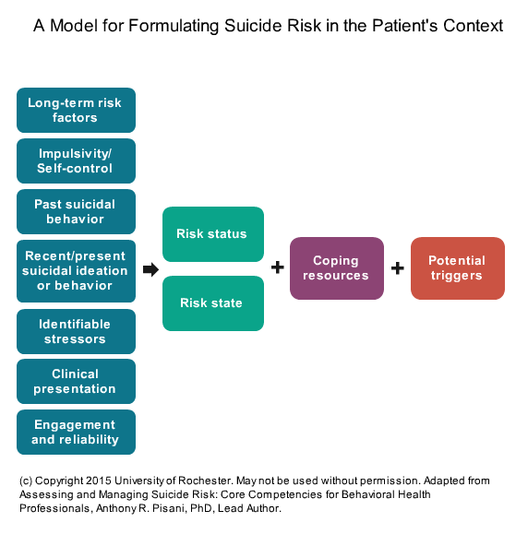
Risk formulations such as this one, when used in a health care setting will assist staff in identifying the indicated level of risk

Slide 9
Engagement happens through patient-provider collaboration on safety and treatment
All patients with suicide risk should have a safety plan in hand when they leave care.
Safety planning is collaborative and includes: lethal means restriction, communication with family members and other caregivers, and regular review and inclusion in the plan

Slide 10
How do we Treat and Transition?
Suicidal patients are often successfully treated when suicidal thoughts, feelings and behaviors are treated directly with effective, evidence-based treatment models.
Successful transitions happen when agencies follow patients through their transitions of care and provide continuous contact, resources, and support, especially after acute care.
CBT
CAMS
(Collaborative Assessment and Management of Suicidality)
DBT

Slide 11
How do we Improve?
Agencies adopting Zero Suicide who apply a data driven approach to inform system changes, will have significantly improved patient outcomes and will provide better care for those at risk
Data collection evaluations are available to all agencies wishing to implement Zero Suicide, it is challenging to improve without a starting point!
So…where do we start?

Slide 12
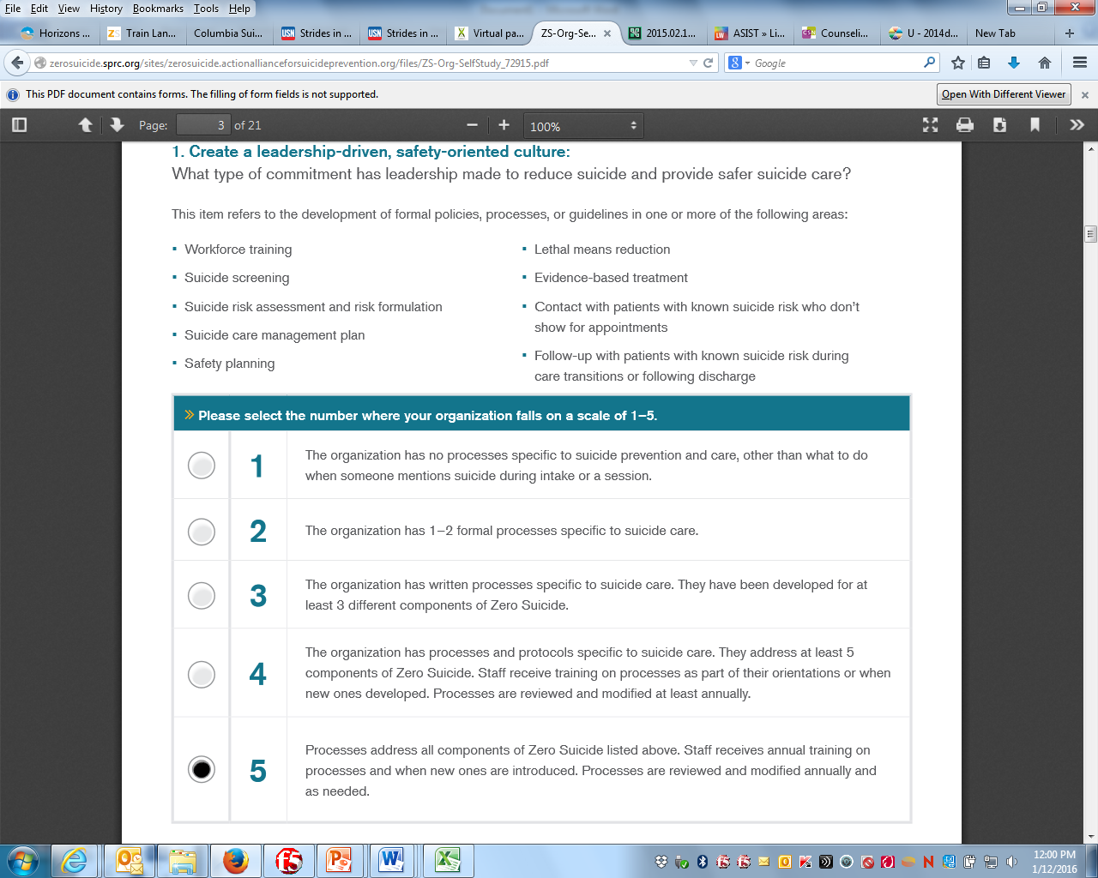
Prior to making plans to implement Zero Suicide, each organization should find a Champion and complete and organizational self-study with others from the organization
ORGANIZATIONAL SELF STUDY
What’s a champion?
A Zero Suicide champions pursue safer, more effective suicide care approaches in health care systems and know that reducing suicides for those at risk is achievable.
Champions see that gaps exist in the delivery of care to those at risk for suicide and advocate for health and behavioral health care organizations to provide more comprehensive and evidence-based care.

Slide 13
Create an Implementation Team!
Meet monthly and as needed
All team members should know it is a 1 year commitment
Team members should have a passion for suicide prevention and client care
Functions:
Maintain organizational commitment and enthusiasm
Draft and implement work plan for Zero Suicide
Determine how to address gaps (from self-study), create goals, and identify needs
Evaluation initiative, with a focus on continuous quality improvement

Slide 14
Is your agency ready to get started?
Do you have questions regarding Zero Suicide?
Great!
Contact Jill Jeter
Youth Suicide Prevention Coordinator
at Jackson County Mental Health
jeterjn@jacksoncounty.org or call 541-770-7776

