Slide 1
All means ALL- Suicide Prevention in a Rural School District
Anne Carloss, Director of Student Services
Hood River County School District
Belinda Ballah, Director of Prevention
Hood River County Prevention Department
Erin Rust, Mental Health Specialist
Hood River County School District
Notes:
Anne

Slide 2
Warm Welcome
Snowball activity
Notes:
Erin

Slide 3
Objectives
The importance of suicide prevention in schools and communities.
The importance of school and community wide buy-in.
Overcoming barriers to implementation.
Notes:
Belinda in the snowball activity we saw that many people have been effected by suicide in some way and therefore our objectives are to highlight how schools and the community can work together to promote suicide prevention. We will also want to call out some of the barriers that we had to overcome.
Our goal has been to insure that all school district staff (from maintenance to cooks to bus drivers to teachers and administrators), students, parents and community members have the opportunity to take a QPR training.

Slide 4
THE WHY?
It’s important and PREVENTABLE!
Second leading cause of death for people ages 10-34
1.4 Million suicide attempts each year
Suicide rates are rising: an increase of 30% between 2000-2016 and a 56% increase for ages 10-24
Oregon’s suicide rate is 33% higher than the national average
Death by suicide in 2016 - 44,965
Death by homicide in 2016 - 19,362
Since 1999 about 169 people have died in school shootings
Between 1999-2020 about 838,850 people have died by suicide
Notes:
Anne. Making it a requirement, Intro Rich

Slide 5
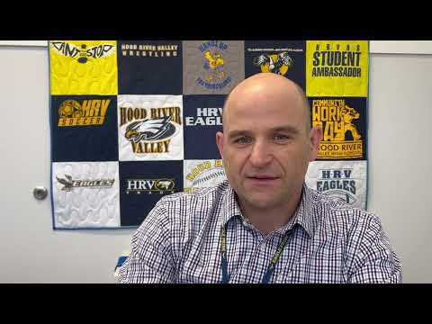
Rich Polkinghorn, Superintendent of HRCSD
https://youtu.be/o6F8917369Q
Notes:
Anne

Slide 6
Good News
School culture can help increase protective factors for students by:
Positive School Experience (PBIS/Trauma Informed Care/Restorative Practices)
Providing an evidenced-based suicide awareness training for students, staff and parents
Schools as Communities
Providing an equitable and safe place for all students - especially for LGBTQ+ and disenfranchised students
Destigmatizing Mental Illness and providing adequate mental health services for underserved populations
Notes:
Anne Good stuff talk about our journey

Slide 7
QPR
Q Question
P Persuade
R Refer
Recognize the warning signs of suicide
Know how to offer hope
Know how to get help and save a life
Notes:
Erin - the training that was most realistic for our district to complete
Importance of two instructors

Slide 8
What does QPR mean?
QPR stands for Question, Persuade, and Refer — the 3 simple steps anyone can learn to help save a life from suicide.
Just as people trained in CPR and the Heimlich Maneuver help save thousands of lives each year, people trained in QPR learn how to recognize the warning signs of a suicide crisis and how to question, persuade, and refer someone to help. Each year thousands of Americans, like you, are saying "Yes" to saving the life of a friend, colleague, sibling, or neighbor.
https://qprinstitute.com/
Notes:
Erin

Slide 9
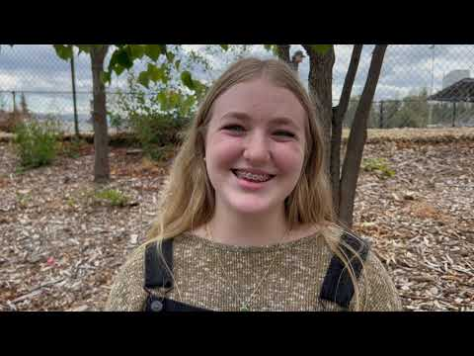
Staff & Student who Participated in QPR Training
https://youtu.be/cQFhs1Dhw2k
Notes:
Erin

Slide 10
What trainings have we done
District goals
Trained approximately 500 HRCSD staff
Administration
Transportation
Maintenance and Facilities
Nutrition Services
Instructional Assistants
Teachers
Librarians
Substitutes (optional)
Started training HRVHS students
One training last year
Two trainings scheduled for this year
Goals:
Train new staff to the district
Recruit bilingual instructors
Offer QPR in Spanish
Provide more trainings to students and community members
Notes:
Erin

Slide 11
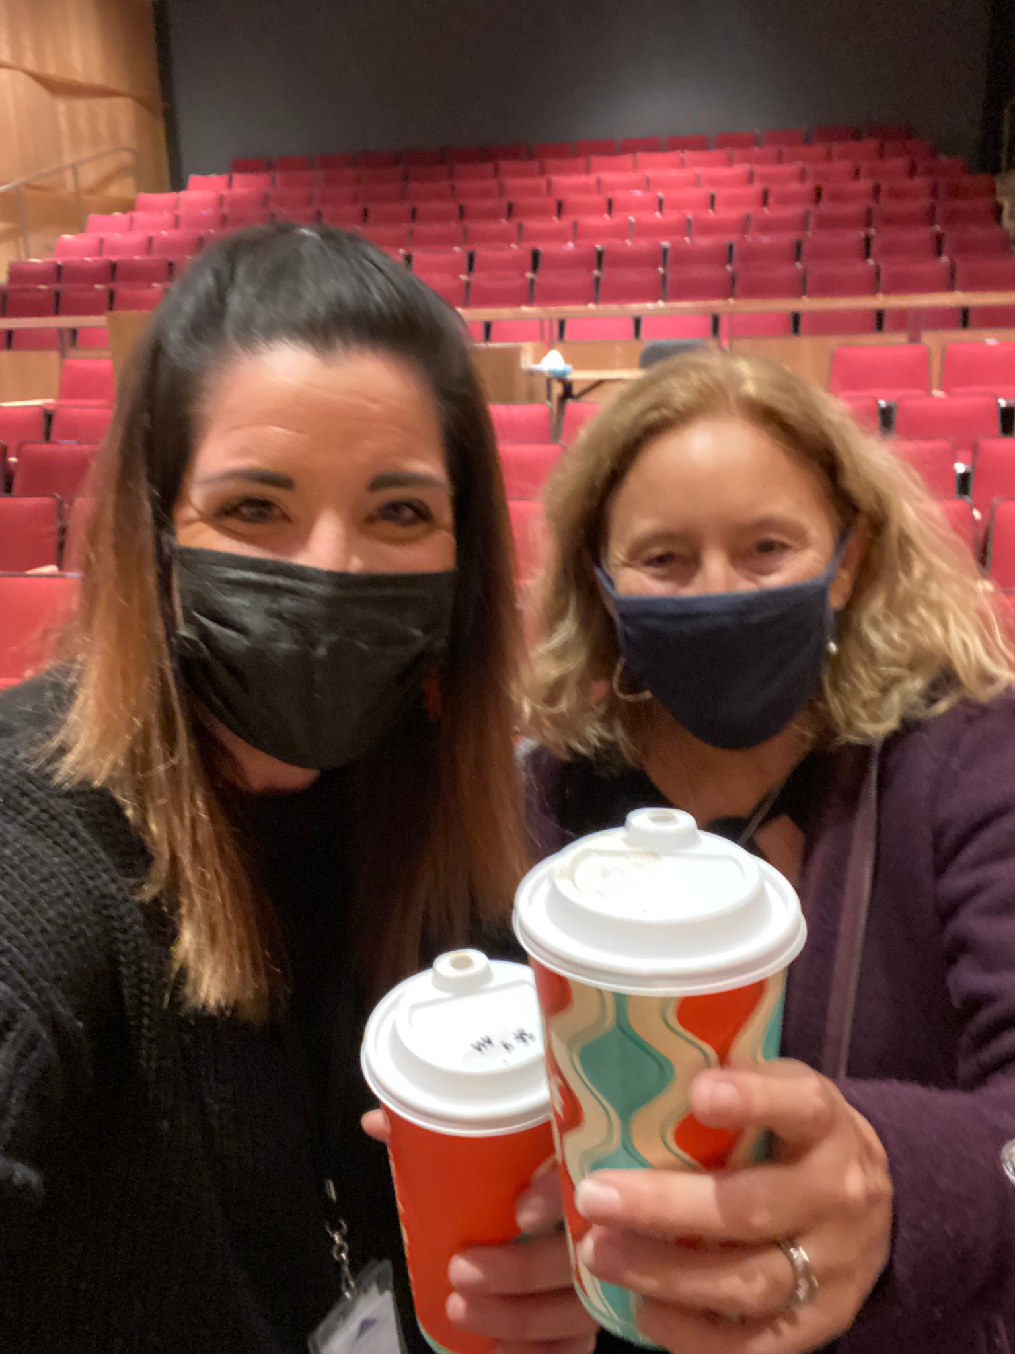
Barriers/ Obstacles
Covid
Staff resistance
Staff feeling like plates were already full
Offered to community but had low participation
Notes:
Resistance from counselors
Gatekeeper -know what everyone else is learning
Common language
Stand firm
Parents feeling overwhelmed (wanted to take the training but couldnt make it work)
Compensating for time

Slide 12
Community Involvement
American Rescue Plan Act of 2021 (ARPA) funds
QPR trainings for community members and parent groups
Adult and Youth MHFA trainings
Notes:
Belinda: We were awarded ARPA funding from our county which allows us to do more of this work at the community level.
Huge collaboration between prevention department and school district, along with the community college. School and cgcc trainings for staff, looking to train students in various classes other local organizations such as fire districts
We are offering trainings for parent groups and community members in hopes that we all will have a common language when discussing suicide prevention. For example, QPR changes the language from saying “committed suicide” to “died by suicide” to help destigmatize mental health illnesses.
Going forward we will be offering MHFA trainings. These trainings go into more detail on different types of mental health illnesses and how to recognize them than QPR does.

Slide 13
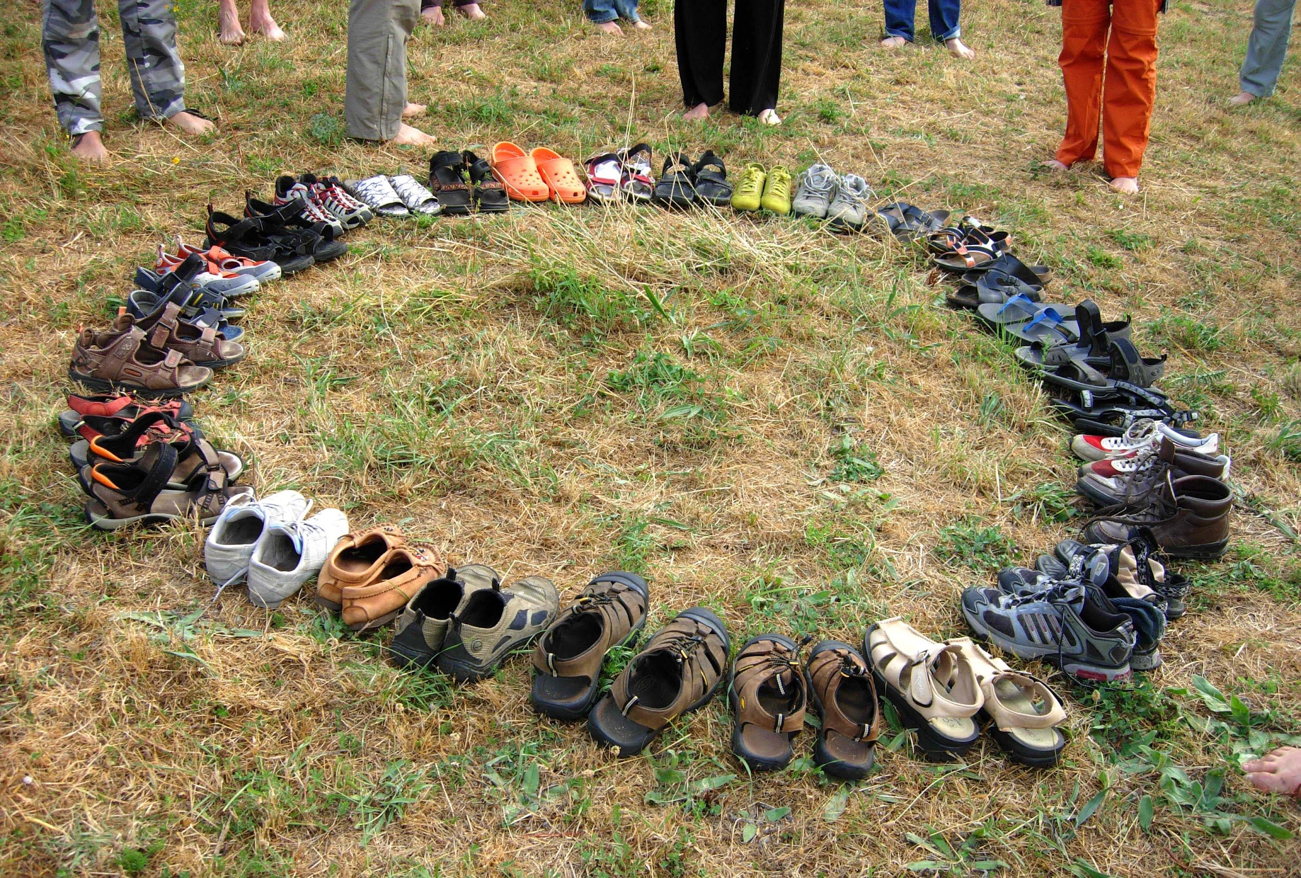
Survivors of Suicide Loss Support Group
Those that have lost someone to suicide are at greater risk of suicide.
So how can we help?
Notes:
Suicide risk is greater in survivors of suicide loss.We know that when a parent dies by suicide their child is 4x more likely to die by suicide. In 2019, we, the HRC Prevention Dept. held our annual international survivors of suicide loss support day. This is always held the Saturday prior to Thanksgiving. This event is an opportunity for survivors of suicide loss to come together to find connection, understanding, and hope through their shared experience. Approximately a dozen people gathered and at the end of the event decided that we wanted more. Our Survivors of Suicide Loss Support group came out of this.

Slide 14
The Gorge Survivors of Suicide Loss Support Group
Notes:
Belinda:
Our principles are to aim for better coping skills, strength in shared experiences, reject stigma, don’t judge, forgive ourselves and reject quilt, embrace humor, expect a better future in a realistic way, never give up hope.
Check in
Discussion
Optimistic closing such as “what are you looking forward to in the next month?”

Slide 15
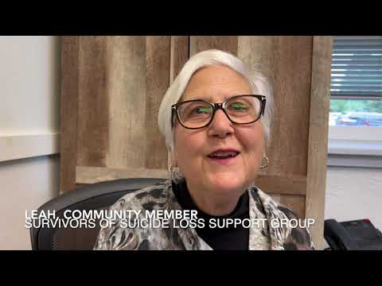
Leah, Survivors of Suicide Loss Support Group Member
https://youtu.be/uIS-6HaM7WM
Notes:
Direct link to video: https://youtu.be/8Z2odJG0KOg

Slide 16
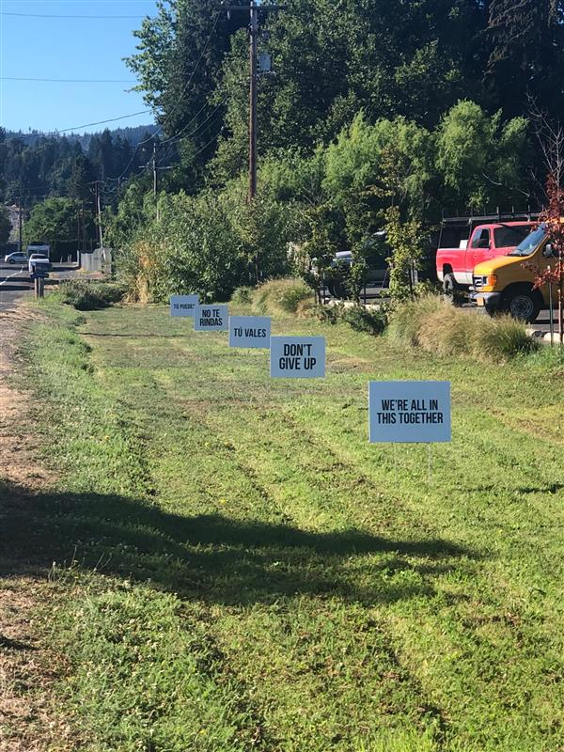
Signs
of
Hope
Notes:
For Suicide Prevention Week we put up 50 signs throughout the county in strategic places such as schools, intersections, Walmart, the Port etc. Also submitted article to the regional newspaper.
Have handed out smaller cards with similar messaging at community events along with our flyers.
We will put these up again in November to promote the International Survivors of Suicide Loss Support day, November 19th
All of these things are to continue to promote suicide prevention awareness and to help destigmize mental health illnesses.

Slide 17
Questions?

