Slide 1
Belonging
Back to the Basics: A Rural Community Effort

Slide 2
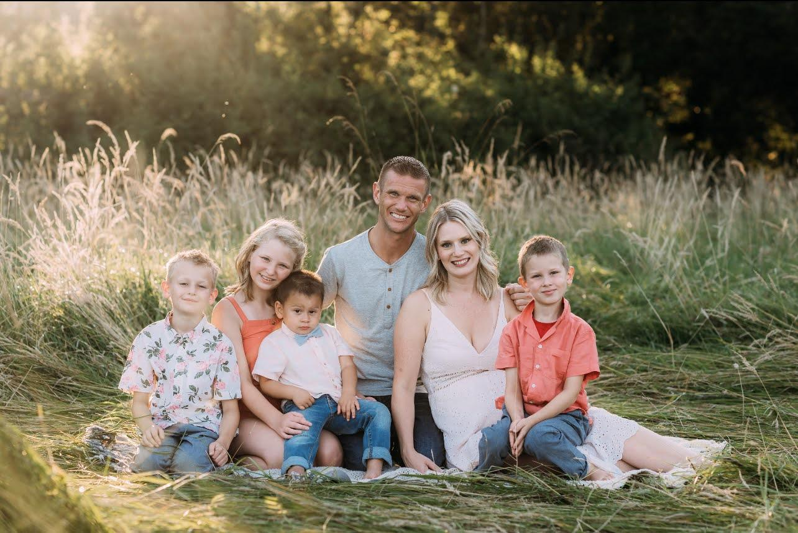
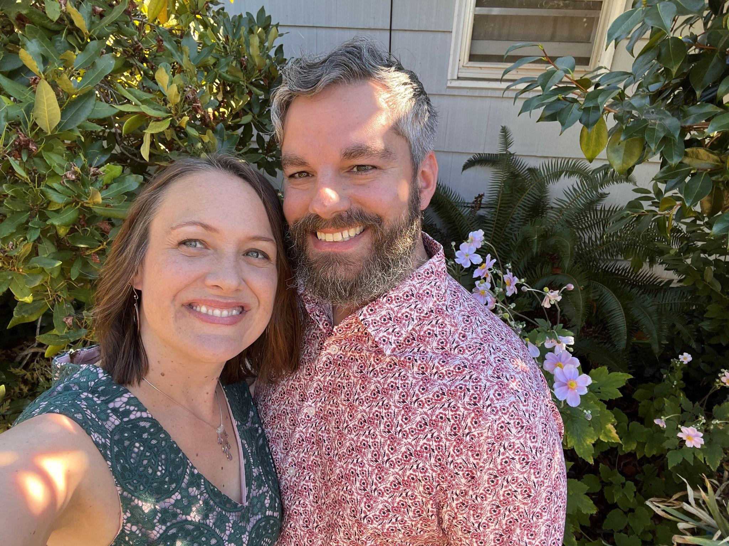
Meet Us!
Sarah Davis (she/her) Teresa Lavagnino (she/her)
Population-based Prevention Coordinator Community Engagement Specialist (Columbia County)
Notes:
Sarah to introduce first. Who I am. My organization. Overview of my work.
Teresa to introduce second. Who I am. My organization. Overview of my work. Funding reason. Overview of the presentation. (Play a game, brief overview of the timeline, share some data, and move into breakout groups for discussion.)

Slide 3
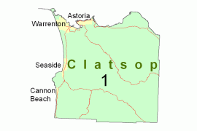
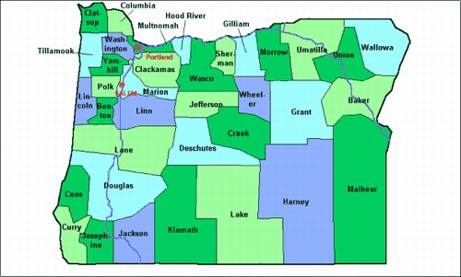
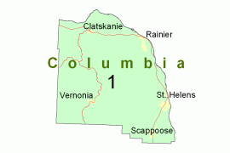
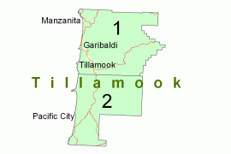
Who we serve
Notes:
Teresa: Our CCO serves the region of Clatsop, Columbia and Tillamook Counties- we’ll mostly be talking about the work in Columbia County today
Where we are (Northwest Oregon); compared to the 3 counties to the east of us, we are similar in land area/square miles and have about 1/15th the number of people

Slide 4
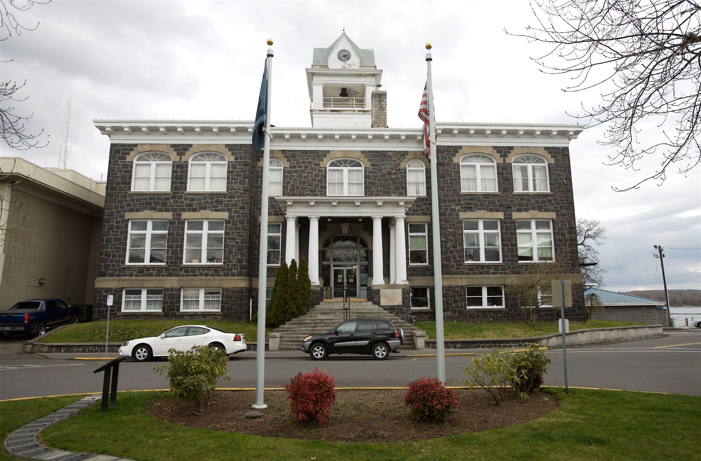
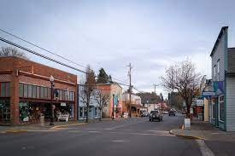
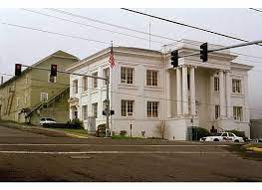
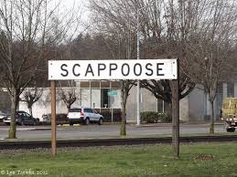
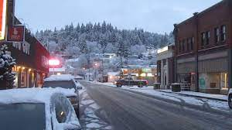
Columbia County Specific Data
Population: 52,117
(2020 United Census Bureau)
Spread over 658.68 Square Miles
Total Suicide Deaths (2018-2022): 47
Average Age of Death: 56.5
Number of Veteran Deaths: 11 (12 unknown)
Notes:
Sarah

Slide 5
The Importance of Suicide Prevention
5-year Suicide Death Rate per 100,00 (age-adjusted, 2015-2019)
Clatsop | Columbia | Tillamook | Oregon*
24 | 22 | 22 | 19
*Ranked 9th nationally out of all states for rates of deaths by suicide in 2019
Total Deaths from Suicide
 | Clatsop | Columbia | Tillamook | Oregon
2017 | 9 | 9 | 6 | 825
2018 | 9 | 17 | 5 | 844
2019 | 8 | 9 | 4 | 908
2020 | 6 | 15 | 5 | 835
Years of Potential Life Lost (before age 75)
 | Clatsop | Columbia | Tillamook
2017 | 195 | 288 | 302
2018 | 219 | 219 | 78
2019 | 231 | 208 | 34
2020 | 158 | 299 | 155
Notes:
Teresa: This data comes from the OHA’s Center for Health Statistics and just reflects the people who are residents of our counties who died by suicide, whether or not they occured in the county.
You can see that in our area, suicide rates are more similar to rates of rural areas in Oregon and devastating when looking at years of potential life lost

Slide 6
Real Time Data in Columbia County
5-year Suicide Death Rate 2018 - 2022
Year | Assigned Male at Birth | Assigned Female at Birth | Total
2018 | 14 | 1 | 15
2019 | 4 | 2 | 6
2020 | 13 | 0 | 13
2021 | 8 | 1 | 9
2022 | 2 | 2 | 4
Total Deaths | 41 | 6 | 47
Notes:
Sarah

Slide 7
Notes:
As I mentioned, SP is an important priority for our CCO, in 2018 Columbia Health Services decides to fully invest staff into SP, with the help of a large grant from our CCO.
We’re going to share some highlights of this 5 year project in this presentation before sharing and discussing some of the tools that we used during our breakout sessions

Slide 8
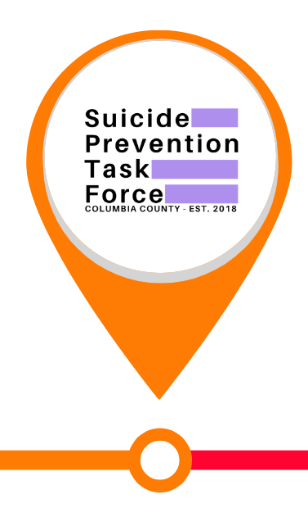
Identified need for support
Suicide Prevention Task Force Established
Awarded SP Grant
Hired SP Coordinator
Notes:
Teresa
In 2018, after a string of youth suicides in our county, Columbia Health Services and local school developed a task force to address the issue and identify and decide they needed more support and to fully invest in suicide prevention.
Suicide Prevention Coordinator worked to coordinate the task force, develop communication and awareness campaigns, and to traini community members provide TOT in Evidence-based SP programming, including QPR, ASIST, Connect Postvention, and Sources of Strength.

Slide 9
ConnectSH program grant awarded
Began offering SP trainings
Notes:
Sarah

Slide 10
New SP Coordinator
Covid
Virtual SP Trainings
Creative Connections - Blog, Virtual Connection
Community Survey
Notes:
Sarah

Slide 11
National virtual learning collaborative
Systems thinking tools to help build partnership & sustainability planning
Notes:
Teresa: In late 2020 through early 2021 Sarah and I, along with 2 taskforce partners, participated in a national collaborative learning institute, ASPIRE (ACES and Suicide Prevention in a Remote Environment) sponsored by UNCIPRC.
When we talk about belonging, we need to talk about ourselves within our systems
Systems thinking allows us to zoom out and to look at all of the rules, people, norms, barrier, etc. so that we can see patterns in addressing our issues and breakdown barriers to include a whole-community approach
Our foundational tool, Strength and Protective Factors framework will be reviewed and discussed during the breakout session!

Slide 12
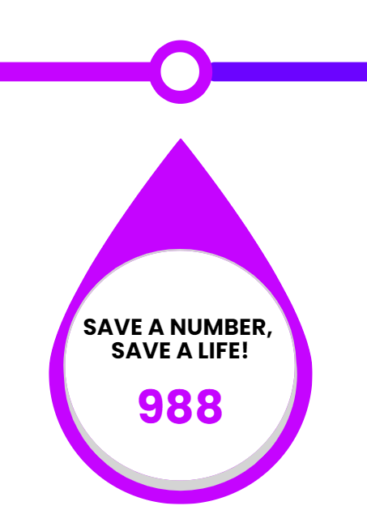
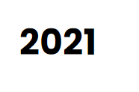
Campaigns launched: - Pop Up in the Park, Save a Number
New Trainers Trained
Notes:
Sarah

Slide 13
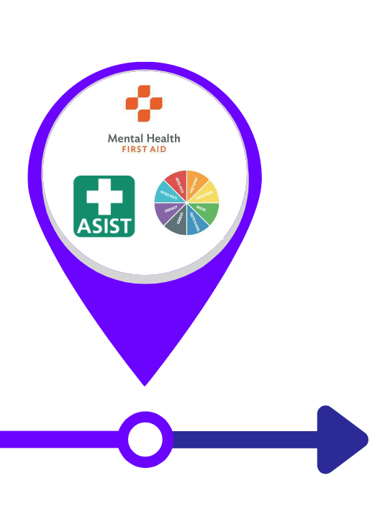
Rainier Days - Belonging Campaign
Additional trainers in community
Schools adopting SP trainings
Culture of Care
Mental Health Expansion
Notes:
Sarah

Slide 14
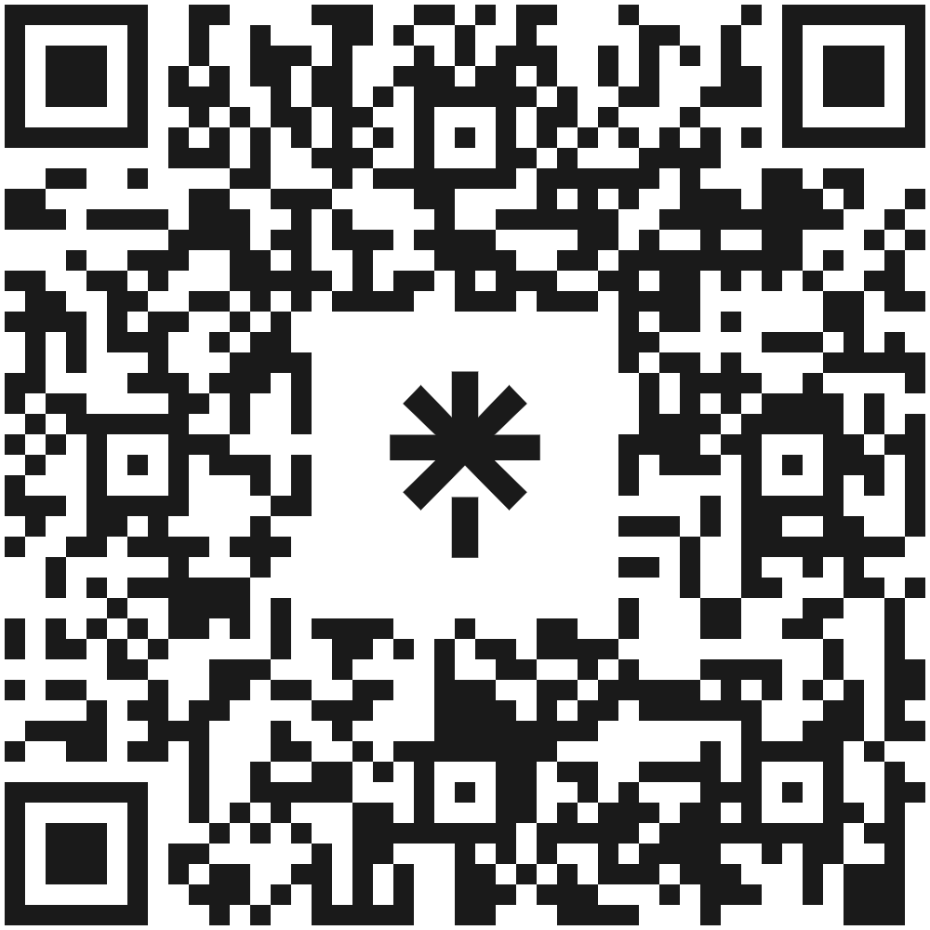
Learn more about columbia Health Services
Join Our Team!

Slide 15
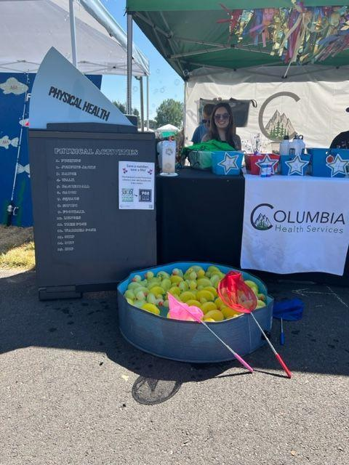
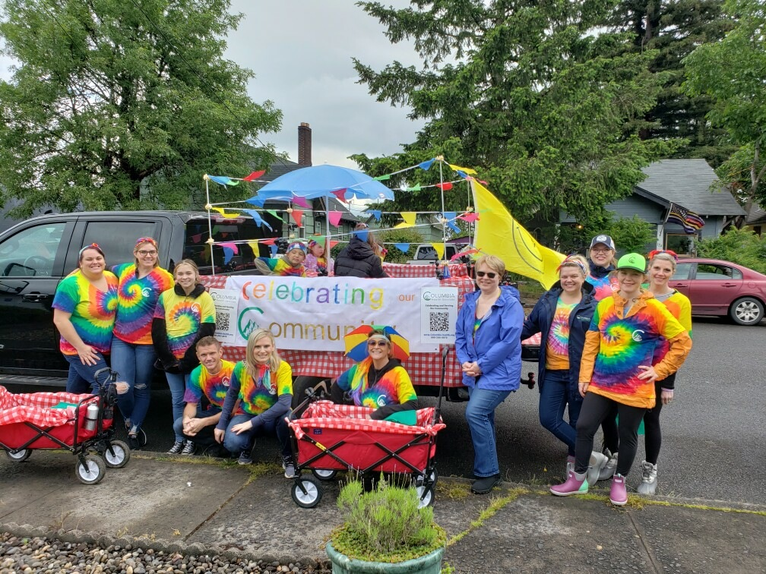
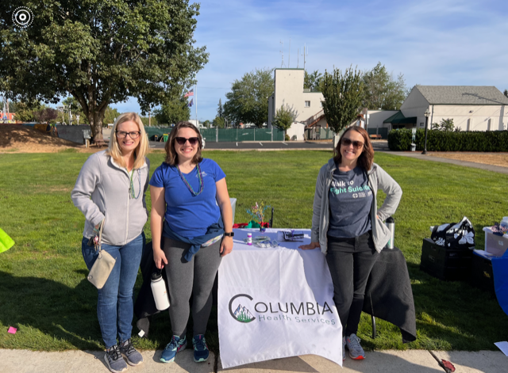
Break-out Groups
Group 1: Community Engagement
Group 2: Data Collection
Group 3: Systems Thinking
Notes:
Sarah

Slide 16
Conclusion, Additional Resources, and Questions
National Crisis Helpline: 988
Trevor Project: (866) 488-7386
Child Abuse Hotline: (855) 503-7233
Suicide data: OHA, Center for Health Statistics Leading causes of death by county​
Columbia Health Services Suicide Prevention:Suicide - Columbia Health Services (columbia-health.org)
UNC Injury Prevention Resource Center: Home | UNC Injury Prevention Research Center
CPCCO: Regional Health Improvement Plan

