Slide 1
No Wrong Door: Reinventing Primary Care to Respond to Depression and Suicide Risk
BY PRAXIS HEALTH
2022 OREGON SUICIDE PREVENTION CONFERENCE

Slide 2
Something to chew on:
Create a version of primary care that helps patients feel like they have come to the right place for any problem.

Slide 3
Suicide Prevention in Primary Care
Introductions
Importance of Primary Care
Universal Screening
Multidisciplinary Teams and Navigation
Access and Workflow
Financial Sustainability
Summary and Next Steps

Slide 4
Primary Care Centric Group Practice
Family Owned
Over 200 Physicians

Slide 5
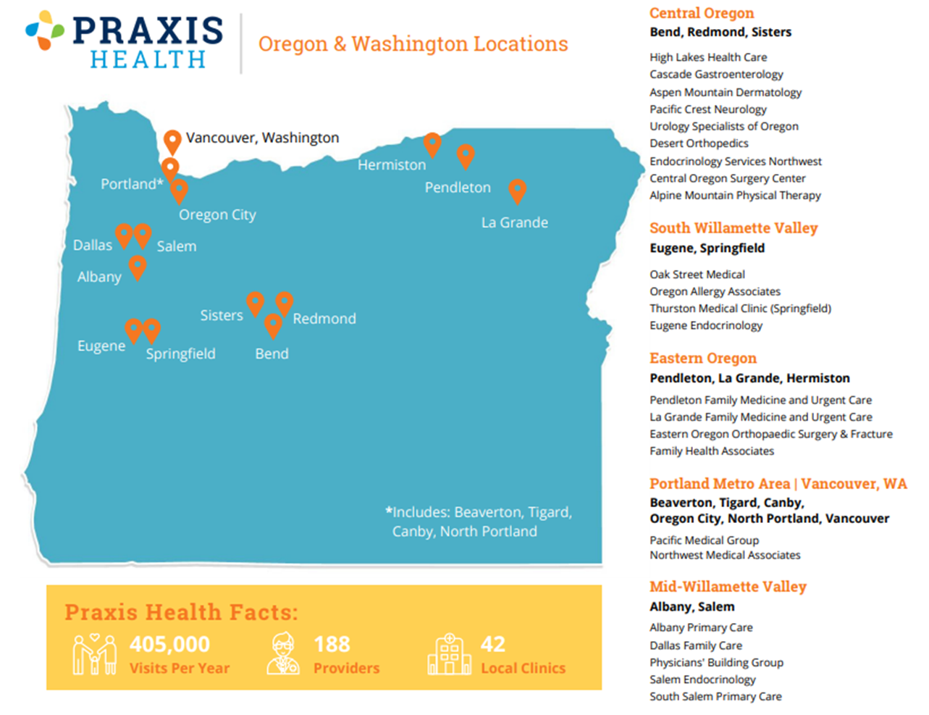

Slide 6
Licensed Psychologist
20 years experience in primary care psychology
Jason Prinster, PhD
4 years at Praxis Health
Passionate about promoting access and decreasing mental health stigma
Director of Primary Care Behavioral Health

Slide 7
22 years as a practicing family physician
5 years as medical director for Praxis Health
Passionate about caring for the whole person
Jessica Morgan, MD
Family Practice Physician

Slide 8
Not a shortage of MH providers
4,837 licensed providers
886 prescribers
Shortage or Access Problem?
250 active primary care providers per 100,000 people
600 active MH providers per 100,000 people
Primary care emphasizes access and timely response to acuity while mental health providers push acuity to commmunity emergency room

Slide 9
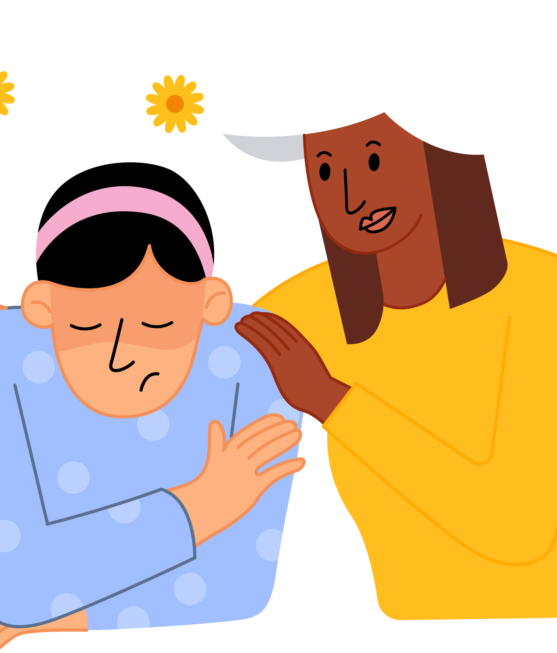
Why Primary Care?
Suicide falls into a "preventable" category
2nd leading cause of death ages 10-34
4th leading cause of death ages 35-54
Overall 10th cause of death in United States
One of 3 leading causes of death in United States that is increaseing
(CDC, 2018; Stone, et al., 2018)

Slide 10
Why Primary Care?
People who die by suicide are more likely to have seen a primary care provider in the previous month than any other health care provider
For a patient at risk for suicide, a visit with the primary care provider may be the only chance to access needed care - especially in rural settings
Large percentage (over 60%) of those who die by suicide in Oregon are not engaged in mental health care at the time of their death

Slide 11
Fewer behavioral health resources in Central and Eastern Oregon
Rural Primary Care
More than 65% of rural Americans get their mental health care from their primary care provider

Slide 12
Primary Care Best Engagement Point
What is mental health access like in your community?
Are you seeing mental health related issues in your clinics?
Are your teams trained in suicide evaluations?

Slide 13
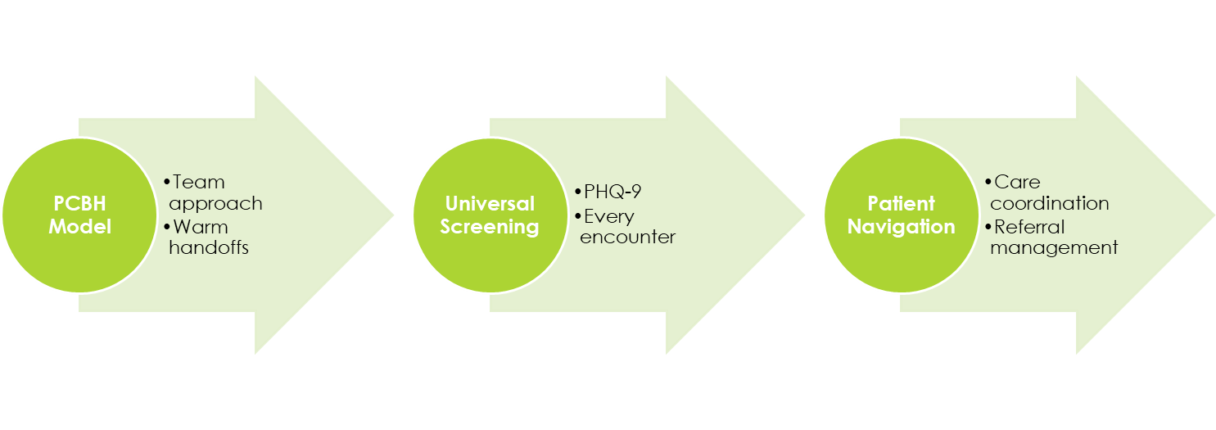
Integration is now the standard in primary care
Not a question of should, rather how

Slide 14
Praxis Health Path to Integration
Psychiatry Consult
Co-located specialty BH
One LCSW embedded for all of Central OR

Slide 15
Prevalence (CDC)
Step 1: Universal Screening
MDD lifetime prevalence 13.2%; 12 mo 5-7%
Adjustment related depression: 12 mo 20%
Depression related conditions 3rd leading cause of loss of QOL in older adults

Slide 16
Screening efficacy
Step 1: Universal Screening
VA and DoD screen 85-100% of patients annually
Up to 40% of cases of depression may be missed in primary care
USPSTF estimates 12-40% of screen positives would meet MDD criteria and majority of positives that do not meet MDD criteia could benefit from intervention (JAMA 2016)
No studies indicate adverse events related to screening

Slide 17
PHQ-9
Over the last 2 weeks, how often have you been bothered by any of the following problems?
Little interest or pleasure in doing things
Feeling down, depressed, or hopeless
Trouble falling or staying asleep, or sleeping too much
Feeling tired or having little energy
Poor appetite or overeating
Feeling bad about yourself—or that you are a failure or have let yourself or your family down
Trouble concentrating on things, such as reading the newspaper or watching television
Moving or speaking so slowly that other people could have noticed? Or the opposite—being so fidgety or restless that you have been moving around a lot more than usual
Thoughts that you would be better off dead or of hurting yourself in some way

Slide 18
"NORMAL" TO MILD
SCORE OF 0 TO 9
PHQ-9 Scoring
MODERATE
SCORE OF 10 TO 14
SEVERE
SCORE OF 15 TO 27

Slide 19
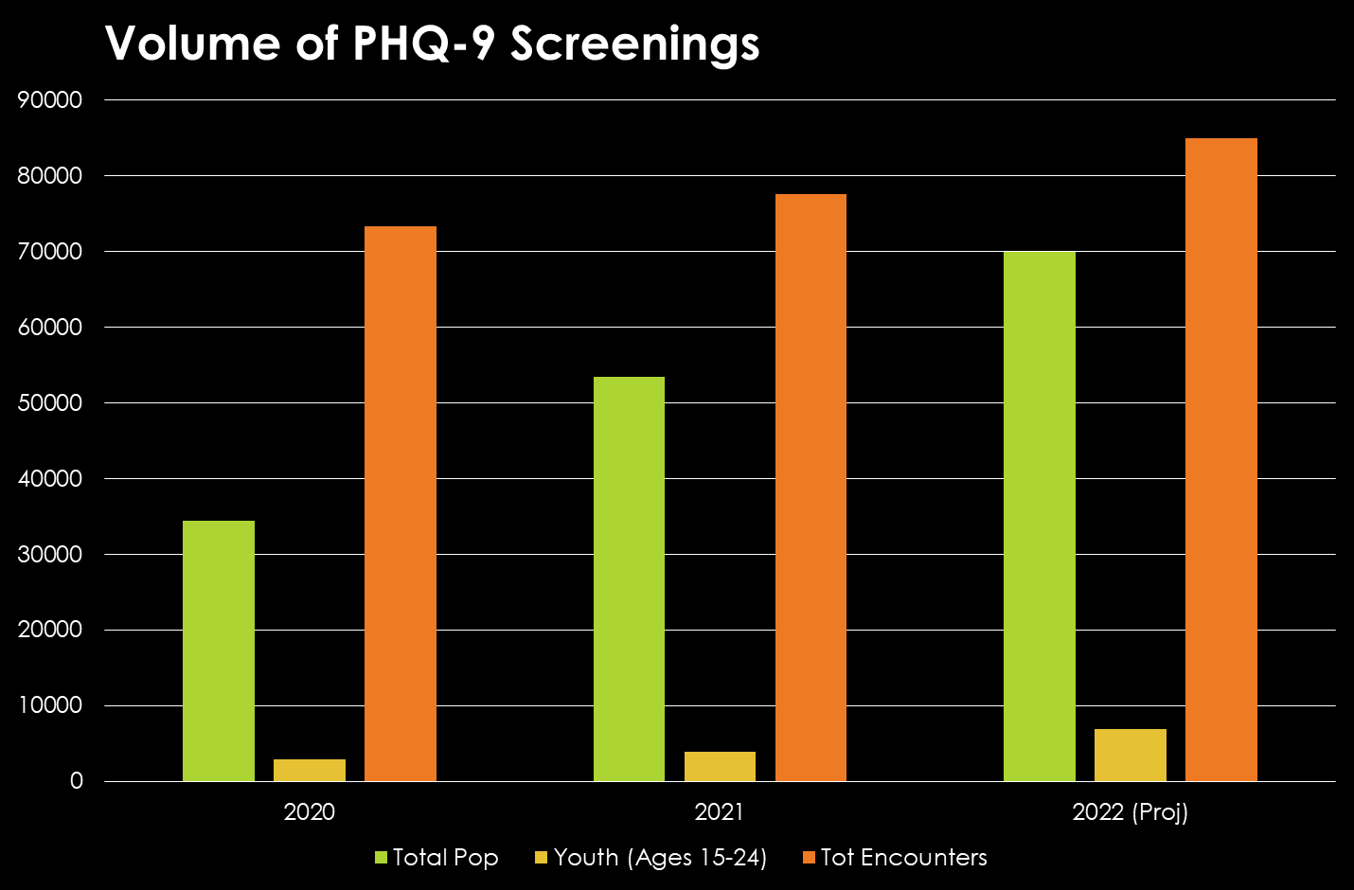
Praxis Health

Slide 20
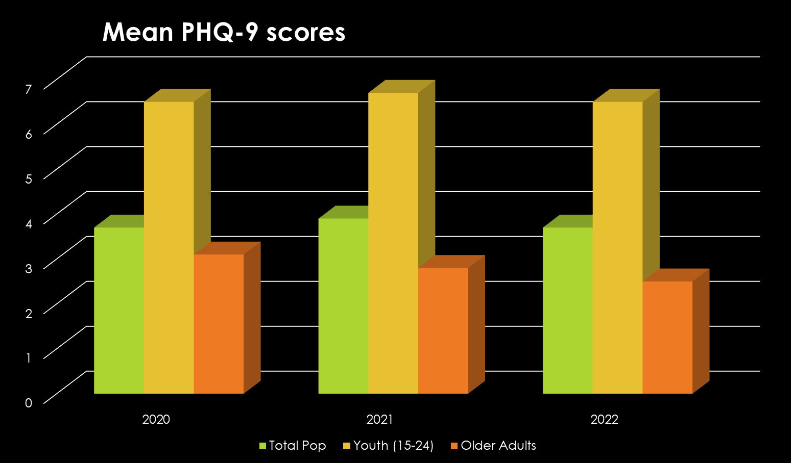
Praxis Health

Slide 21
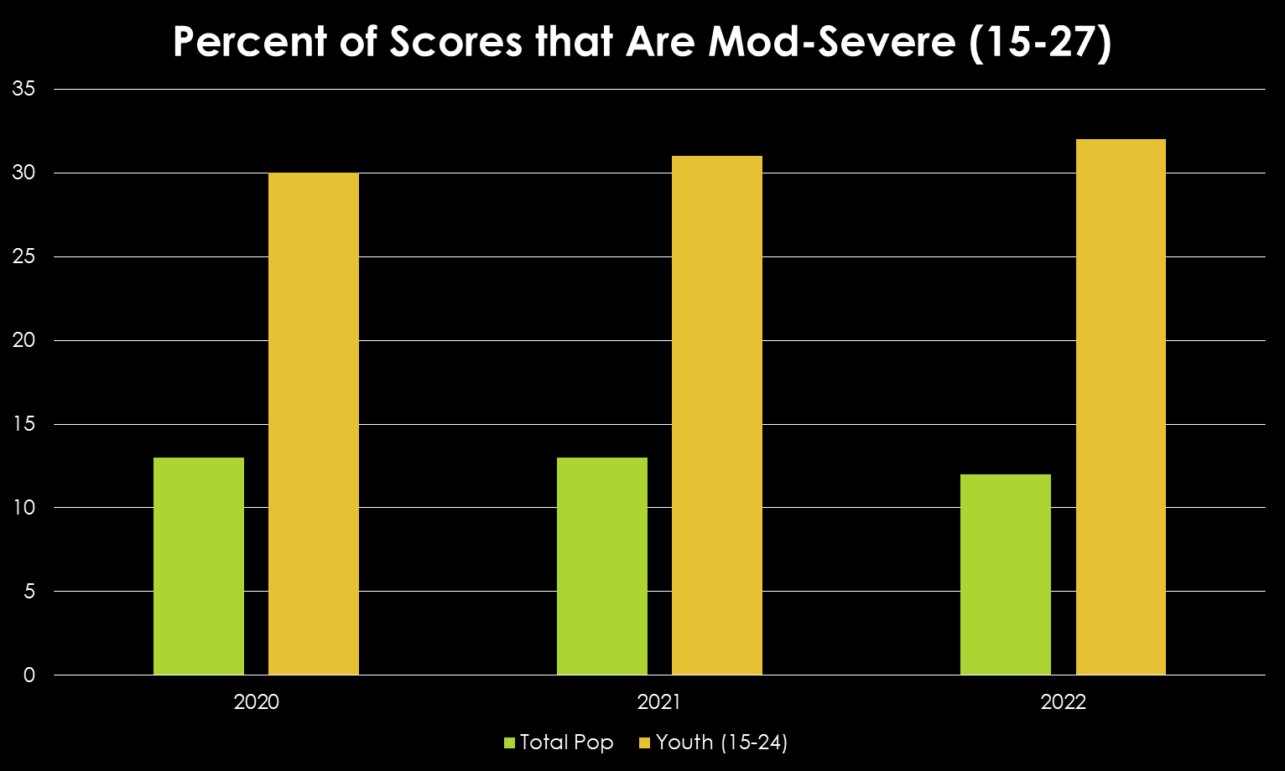
Praxis Health

Slide 22
What is it?
Step 2:
Primary Care Behavioral Health
Consultant model
Work side-by-side with primary care
Goal is to improve PCP management of behavioral issues and improve satisfaction
Wide variety of interventions and goals
Brief visits, limited follow up
Immediate feedback to PCP
Any behavior problem, any age
Immediate access with minimal barriers
Population health principles

Slide 23
PCBH Model
Interdisciplinary Teams
Decade spent refining model delivery issues
PCBH model adopted by Community Health Care System, many HMOs, DoD, VA, and more recently in PC pratices
Economic reimbursement issues still being sorted out

Slide 24
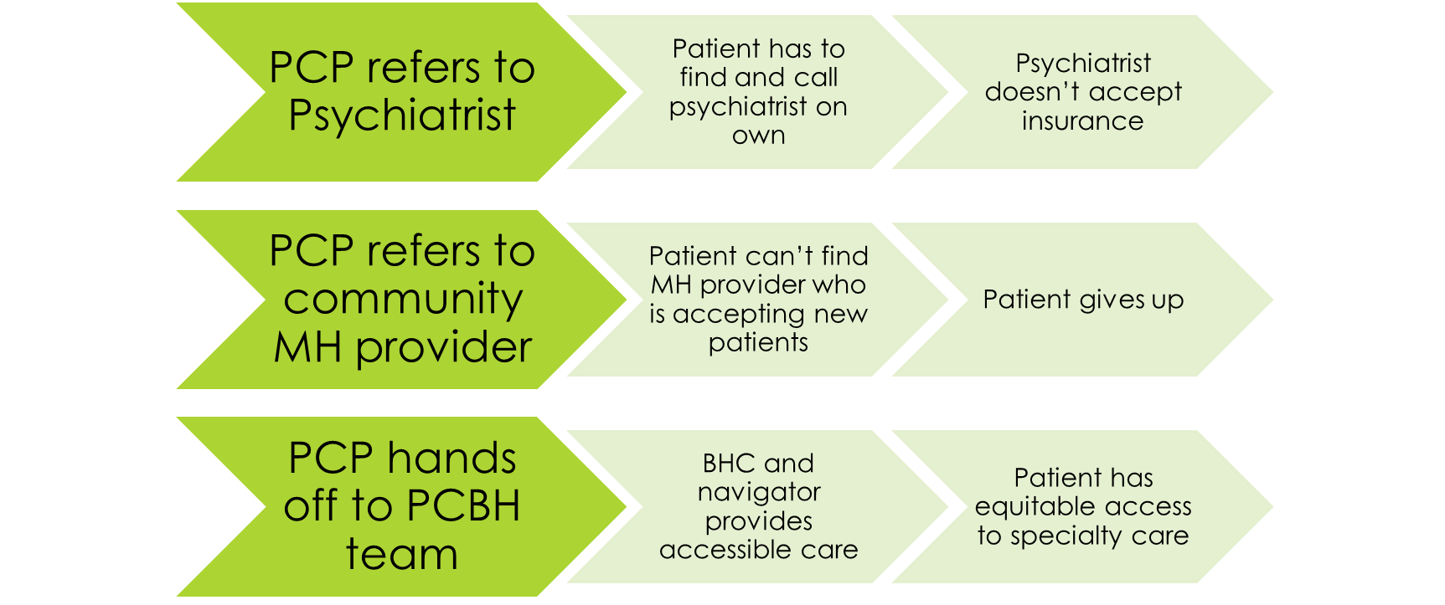
Common
Problem
Common
Problem

Slide 25
PCBH Model

Slide 26
Patient-centered, sustainable service delivery intervention that removes barriers to care
Patient
Navigation
Screening
Diagnosis
Care Integration
Connect to Resources

Slide 27
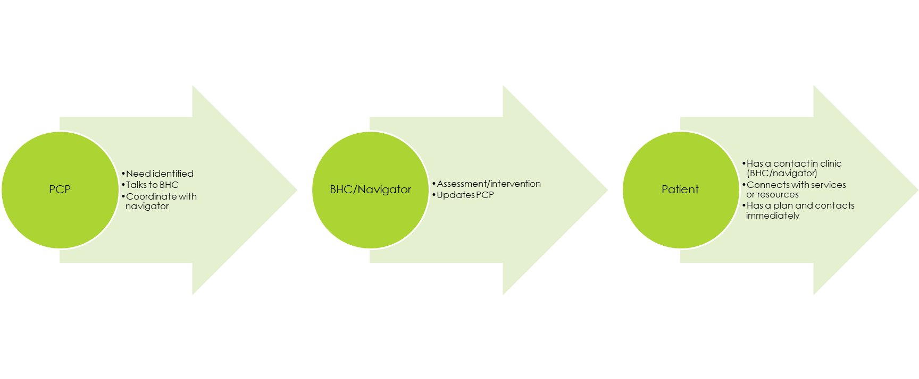
Clinic Workflow

Slide 28
Behavioral Health Team
Meet with patient to identify current problems contributing to suicidal thoughts
Assess for additional risk and protective factors
Collaboratively work with patient to plan for safety if patient is agreeable and does not have an active plan
Provide brief interventions
Follow up

Slide 29
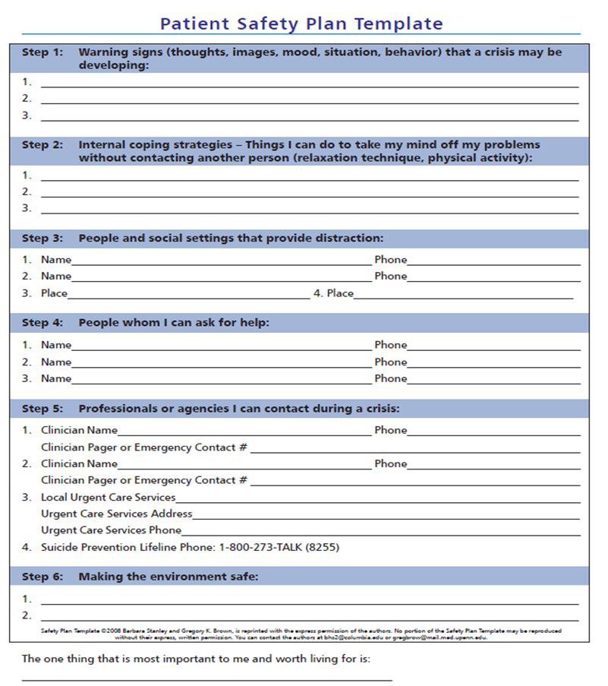
Safety Planning
Collaborative process with patient
Coordinate with current MH provider or assist in timely referral to MH provider to establish services
Bridge or hold in primary care
(Stanley & Brown, 2015)

Slide 30
After Safety Planning
Implement seamless and open access follow-up
Import safety plan into EHR, share with team, review at future visits
Expedite referral into community for specialty treatment if needed
Follow-up care contacts
Virtual support, remote patient moitoring

Slide 31
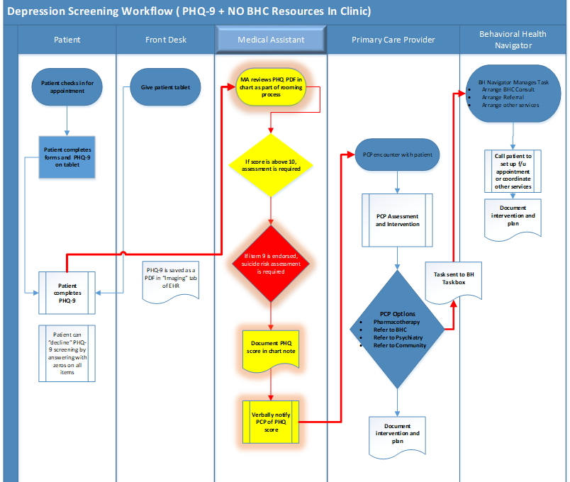

Slide 32
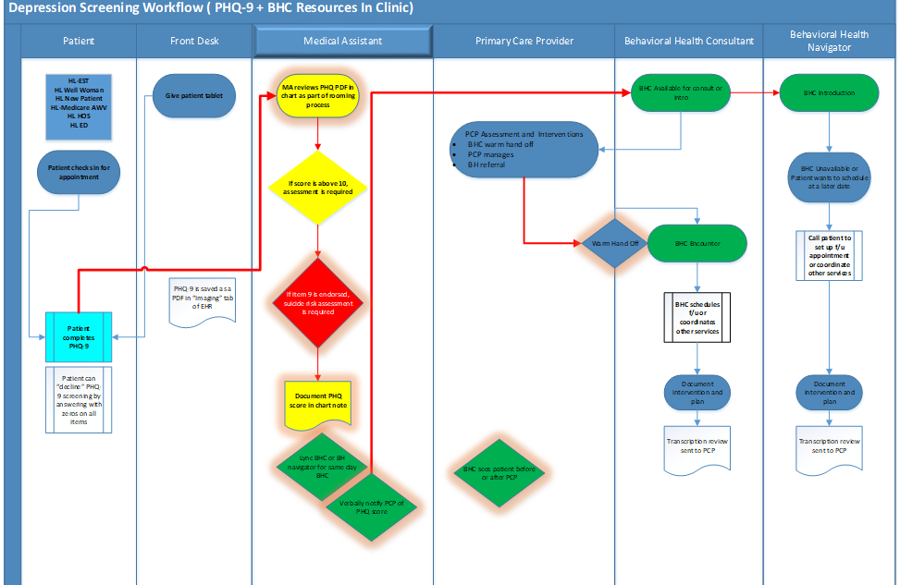

Slide 33
Financial Sustainability
If there's a will, there's a way...

Slide 34
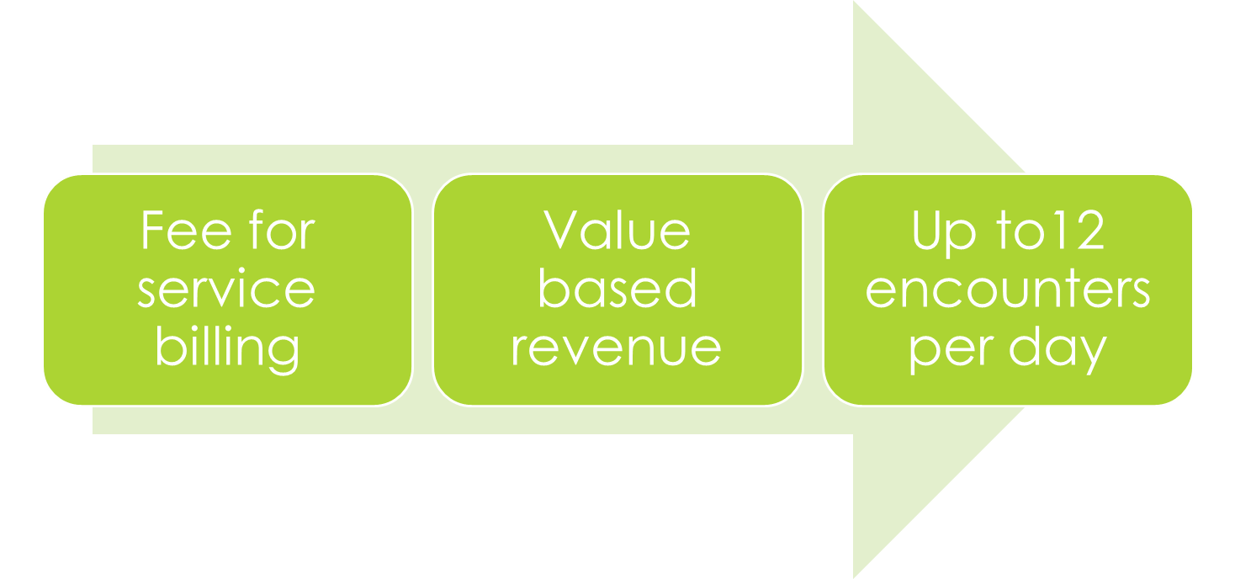

Slide 35
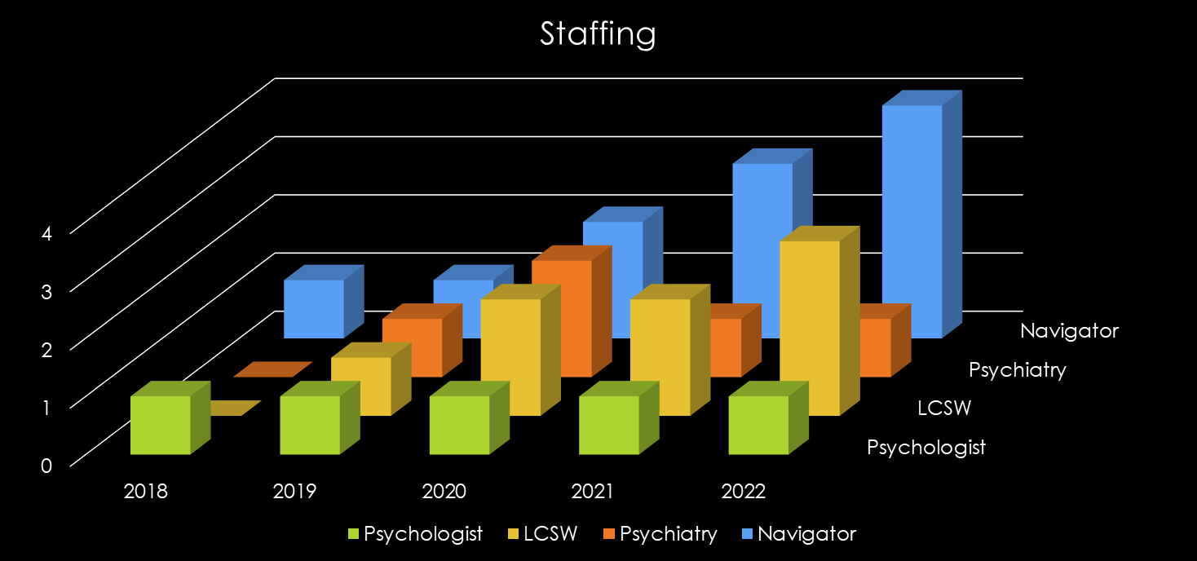

Slide 38
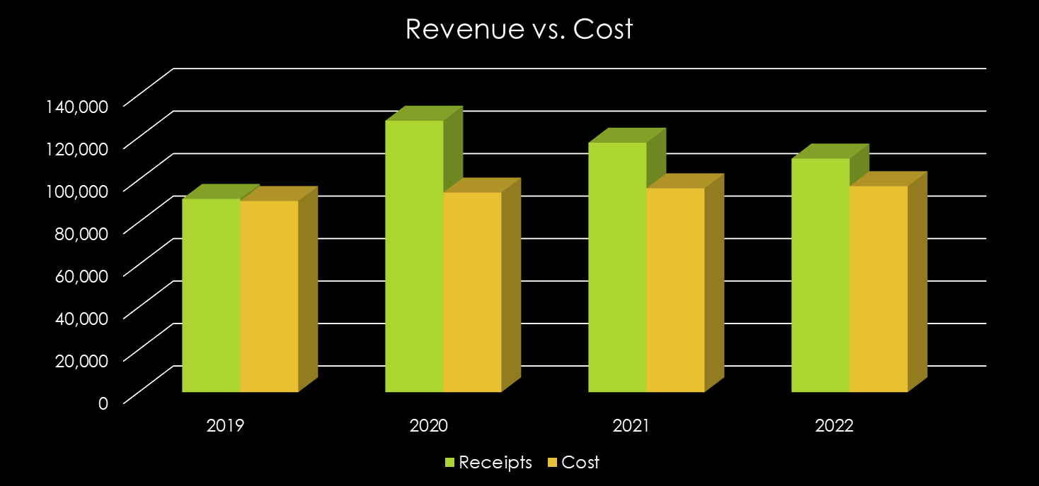

Slide 39
Suicide Prevention in Primary Care
Importance of Primary Care
Universal Screening
Multidisciplinary Teams and Navigation
Access and Workflow
Financial Sustainability

