Slide 1
Holding Hope.
Jill Baker, LSC
Youth Suicide Prevention Coordinator
Oregon Health Authority

Slide 3
2022 STATE NEEDS: INFRASTRUCTURE

Slide 4
A look back

Slide 5
2020: A year that was 467 years long
COVID 19
Quarantine
Social Distancing
Online School
Toilet Paper Shortage
Murder Hornets
Wildfires
George Floyd’s Murder
Social Unrest
Political Turmoil
Carole Baskin and Tiger King

Slide 6
Planting seeds

Slide 10
Social networks

Slide 12
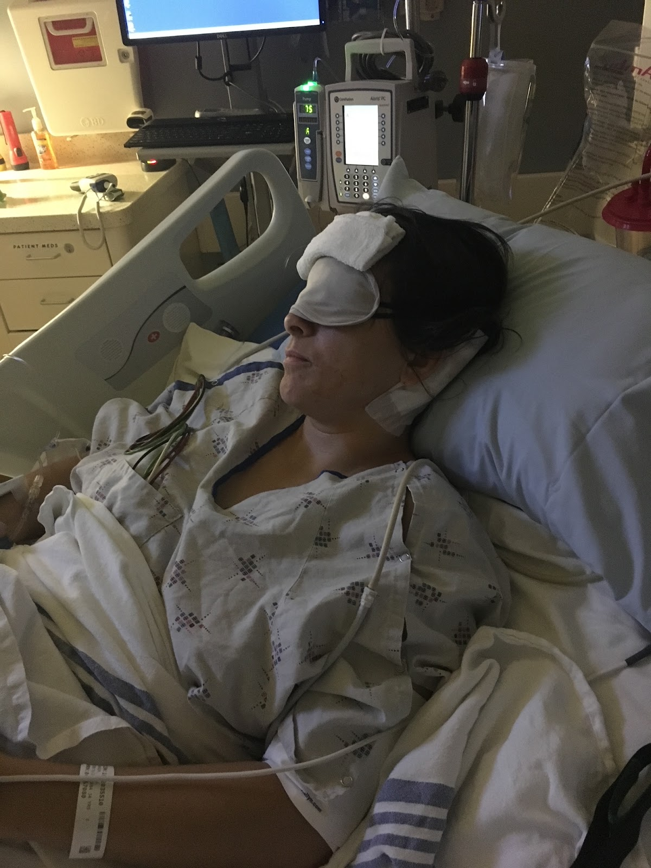

Slide 13
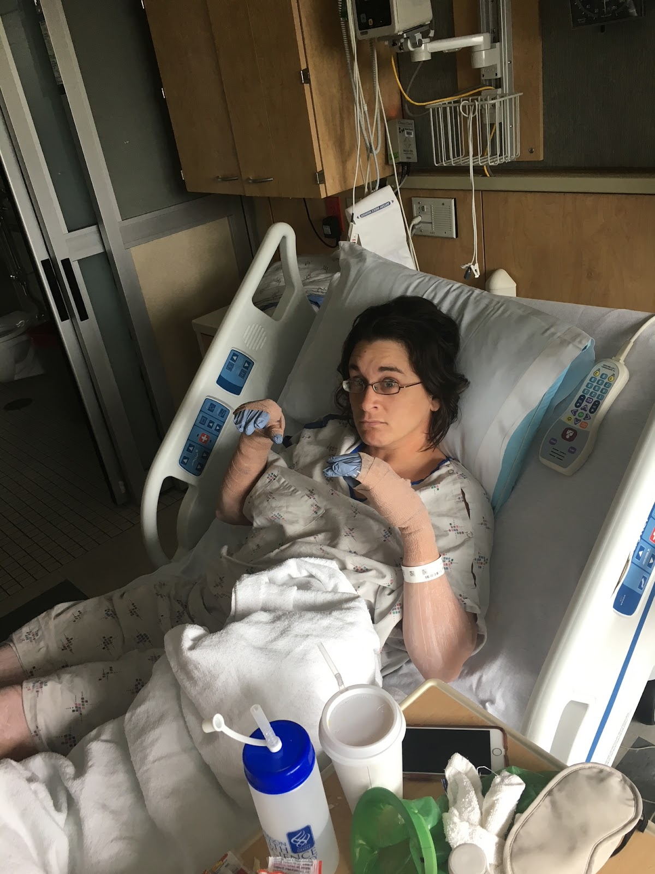

Slide 16
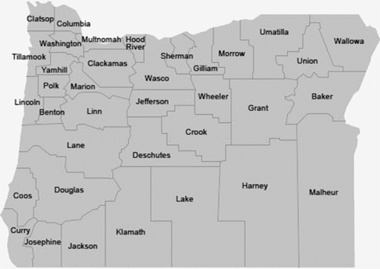

Slide 17
988 and mobile crisis and stabilization services
Notes:
OHA’s goal is to see 988, along with historic investments in behavioral healthcare made by the Oregon Legislature, spur needed change.
The launch of 988 is an exciting opportunity to reimagine how crisis services are provided in Oregon.
Oregon is investing:
Approximately $7 million in Oregon’s two 988 call centers ($6.1M for Lines for Life, $1M for Northwest Human Services) to build staff capacity for culturally, linguistically and developmentally specific services.
Approximately $39 million to Community Mental Health Programs to enhance and expand community-based mobile crisis intervention services
In the longer term, OHA's vision is to build a robust crisis care response system that links callers to community-based providers who can deliver a full range of crisis care services.

Slide 19
I AM ENOUGH.
I am bringing what I have when I can.
Multitasking is for birds.
I am not a bird.
There is space for wellness in my life and in my work.
Together this work is possible.
Control of all the things is not mine to carry.
I am doing the best I can.
I will show up.
I will ask for help.
I will look for hope.

