Slide 1



RECONNECTING CAMPUS SUICIDE PREVENTION COMMUNITIES
PRESENTED AT THE OREGON SUICIDE PREVENTION CONFERENCE
ASHLAND, OREGON
OCTOBER 11, 2022
Notes:
Welcome!
This presentation is designed to connect campus suicide prevention communities through brief presentations and a discussion.
We will be gathering information from you all – and it’s designed to be participatory.
So, to get our brain juices flowing following lunch, we have a brief activity.

Slide 2
WHO ARE YOU?

Slide 3
WHO ARE YOU?
Public or Private school – or just curious

Slide 4
WHO ARE YOU?
Public or Private school – or just curious
4 year or 2 year school – or just curious

Slide 5
WHO ARE YOU?
Public or Private school – or just curious
4 year or 2 year school – or just curious
Occupation: Peer advocacy, systems work, direct service provider, trainer
Notes:
Great. Everyone please take your seats.
On your seat is an index card and a pen.

Slide 6

OCUSPP: Oregon College and University Suicide Prevention Project
Notes:
The Oregon College & University Suicide Prevention Project (OCUSPP) is a joint effort by colleges and universities in Oregon to reduce suicide risk on our campuses. We believe that suicide is often preventable, and we’ve developed a multifaceted program to raise awareness on our campuses and to assist at-risk students in receiving appropriate help.
The consortium grew out of collaboration supported by a federal grant. In 2005, the eight public universities in Oregon received a 3-year campus suicide prevention grant from the Substance Abuse and Mental Health Services Administration (SAMHSA) under the Garrett Lee Smith Memorial Act. In 2008, we sought and obtained funding from member institutions to continue our work. We also welcomed private colleges and community colleges into the consortium so that the knowledge gained from implementing the grant could benefit a wider group of students.

Slide 7
OCUSPP: Oregon College and University Suicide Prevention Project
Member Benefits:
Fall and Spring bi-annual meetings with voting power
A highly reduced rate at our annual trainings for ≈6 CEs for everyone from your institution (e.g. $30 member rate vs. $125 non-member rate)
Annual conference fee coverage for 2 members/year to a regional or national conference on suicide prevention
Access to a shared materials library (e.g. presentations, postvention materials, etc.)
Free access to webinars from the American Association of Suicidology (AAS)
Free access to the Suicide and Life-Threatening Behaviors journal
Member listserv
Annual self-study survey based on JED Campus Model
Annual Resource Fee: $1,155.00 > 15,000 students
$800.00 < 15,001 students and > 6,999 students
$400.00 < 7,000 students
Notes:
The Oregon College & University Suicide Prevention Project (OCUSPP) is a joint effort by colleges and universities in Oregon to reduce suicide risk on our campuses. We believe that suicide is often preventable, and we’ve developed a multifaceted program to raise awareness on our campuses and to assist at-risk students in receiving appropriate help.
The consortium grew out of collaboration supported by a federal grant. In 2005, the eight public universities in Oregon received a 3-year campus suicide prevention grant from the Substance Abuse and Mental Health Services Administration (SAMHSA) under the Garrett Lee Smith Memorial Act. In 2008, we sought and obtained funding from member institutions to continue our work. We also welcomed private colleges and community colleges into the consortium so that the knowledge gained from implementing the grant could benefit a wider group of students.

Slide 8






JOIN US
Notes:
Aliza: We will now hear from four OCUSPP members about their SP programs.

Slide 9

On-Campus Prevention Efforts
Columbia-Suicide Severity Rating Scale (C-SSRS)
  Resident Assistant (RA) Training – Prevention & Intervention
  Campus Safety Training – Prevention & Intervention
Student Affairs Division-wide Training – Prevention & Resources
Faculty/Staff Training at Convocation – Prevention & Resources
In Clinic: Collaborative Assessment and Management of Suicidality (CAMS)
Monthly Mental Health Screenings - Anxiety, Depression, Relationships, Substance Abuse, etc.

Slide 10

Community Collaboration
Partnered with Klamath Basin Behavioral Health (KBBH)- Community Mental Health Agency
  KBBH Mobile Crisis Unit – More intensive interventions
    Will come to campus to evaluate instead of sending student to the ER
    Place “holds” on at-risk individuals
    Initiate Civil Commitment process, when appropriate
    Help find placement solutions, both acute and long-term hospitalization
  Postvention Support – A work in progress

Slide 11
Campus Suicide Prevention Program
Training/Education
    QPR, ASIST and other suicide first aid trainings tailored to the needs of specific groups on campus
Resources for Suicide Prevention
    ProtoCall (after-hours counseling support)
    Social Media Campaigns/Blog Posts
    Community Suicide Prevention Training Program
    Tabling events
Environmental Safety
    Firearms, Medication Storage, & Promoting safe prescription drug disposal
Postvention
    Planning & trainings
    Suicide loss survivor presentations
Hannah Hoeflich PsyD: hoefliha@ohsu.edu
Notes:
OHSU’s Community Suicide Prevention program for students and postdoctoral scholars has four main objectives. These include training/education, resource development, environmental safety, and postvention. Their Suicide Prevention Program Manager, Hannah Hoeflich could not be here today, but she invites you to reach out via email if you have any questions about the OHSU program.
They strive to have all community members trained in basic skills for suicide first aid. They deliver QPR trainings, and have some more tailored programs to meet the needs of specific groups. For example, medical trainees have a peer-led portion of their program, and there is a specialized, culturally specific curriculum for indigenous students. Additionally, OHSU offers Advanced Suicide Prevention Skills Training (ASIST) that is co-facilitated by Jade Osilla MA (former Assistant Director for Prevention at Lines for Life). The goal is to have ASIST trained individuals spread throughout the organization as resources. ASIST has been a very popular program at OHSU, and they get very positive feedback.
In terms of direct resources for students and postdocs, the OHSU Student Health and Wellness Center contracts with ProtoCall to provide afterhours mental health support.
The counseling center also disseminates suicide prevention information through social media, blog posts, and tabling events. Much of this work happens with the help of their suicide prevention practicum trainee from Pacific University’s PsyD program.
They also give out free gun locks and safes with educational information for responsible gun storage and safe medication storage. They are hoping to have medication drop boxes installed on campus, but for now, they are promoting medication disposal events.
Finally, they work on postvention planning and education. They have developed postvention plans for campus to prepare for a coordinated effort in the case of a suicide. They have also done trainings educating faculty on topic of postvention, and they have a group of suicide loss survivors who share their experiences and advice for community members in grand rounds presentations.

Slide 12
Challenges to Delivering Behavioral Health Services
Not enough access for students
  Bimonthly counseling
Difficulty recruiting and retaining diverse staff
Provider Burnout
Shortage of community referral options
  For students who need higher levels of care
  For specialty care
Notes:
Some of the challenges they face when is comes to providing behavioral health services are that they simply do not have enough hours in the day or staffing to provide frequent sessions to students who need them. Most students in the clinic are seen every 2-3 weeks. They also struggle to hire and retain diverse staff, and the providers on staff have been struggling with burnout. Add to this, the needs of the student body have increased, with more students in crisis and increasingly complex presentations. The staff have not been able to refer students who need higher levels of care to community resources because the community resources are full and have long waitlists.

Slide 13
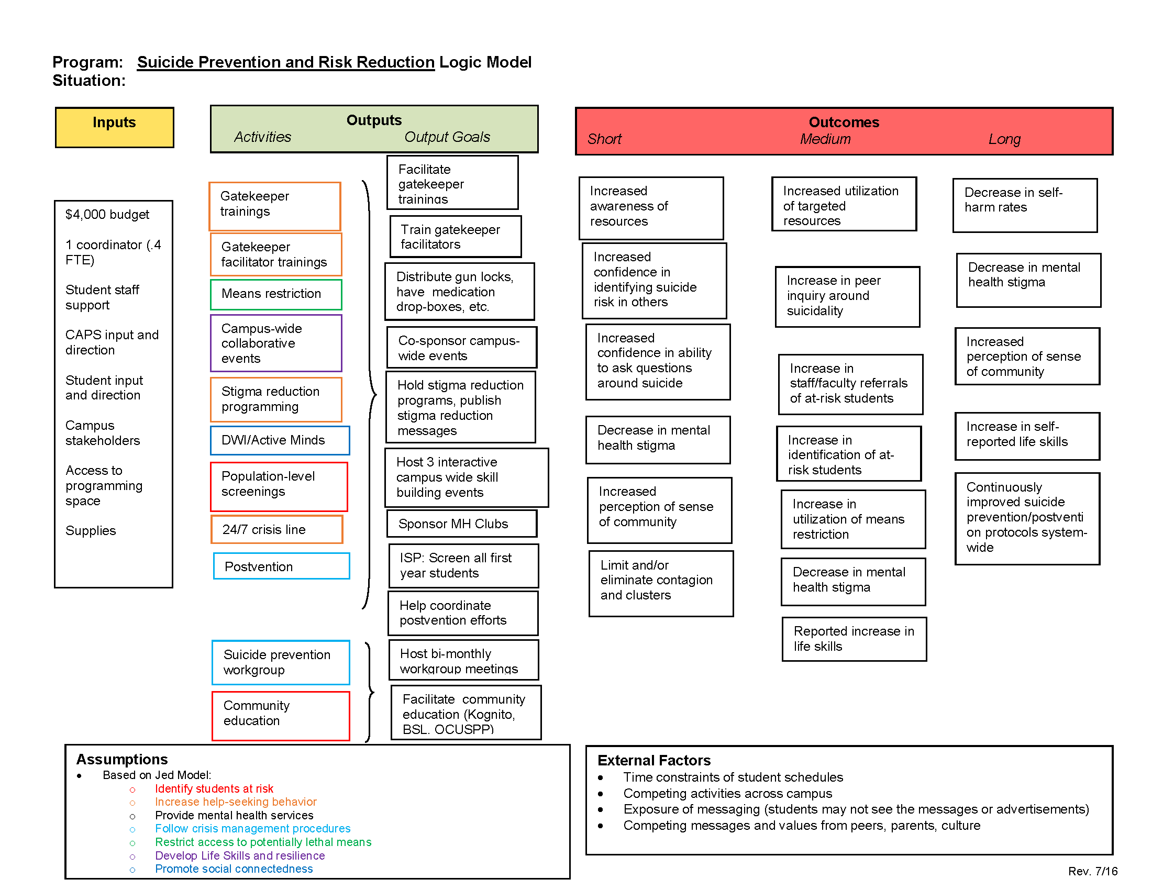
Suicide Prevention at OSU
Notes:
Stress can have lasting effects that feed into cycles of more stress. This feedback loop of stress can cause you to lose sleep, not reach out for support, reach towards low nutrition food and rely on caffeine, and cause an increase in drug and alcohol use.
https://docs.google.com/document/d/1Bz1D2zuYWtnlNFfvnd3Jv_1DyCzPfbqBXWmb98chcNM/edit?usp=sharing

Slide 14
Current Challenges at OSU
Staff vacancies: failed searches, staff turnover
Ever-increasing demand for services: long wait lists
Stigma embedded in high-stress science majors (engineering, Vet. Med, etc.)
Underutilized by communities of color due to lack of trust & representation
Community providers have waitlists, CAPS is a short term therapy service
Resistance to mandating Kognito for Faculty/Staff; loss of required student health class (had Kognito as an embedded assignment)
Notes:
Some of you may be familiar with this TED Talk by health psychologist Kelly McGonigal called “Make Stress Your Friend”. The video discusses how stress is a fight-flight-or freeze mechanism that affects our bodies both psychologically and physiologically. In McGonigal’s work, she found that changing your mindset about stress changes your psychological response. This means that we must reframe stress as a helpful tool that gets your body to prepare for your day. This means that instead of thinking of stress as a hindrance to reach our goals, we must think of it instead as a tool that gets us ready to conquer the day that lays ahead. Reframing our thoughts on stress causes our bodies to function differently and creates the biology of courage.
In fact, it was found that those who view stress as a bad thing will have a negative cardiovascular response, meaning that their arteries will restrict allowing less blood flow. Those who view stress as a positive thing will have improved cardiological stress response meaning that during stressful situations, their arteries will open allowing more blood flow.
Oxytocin is a hormone that you may be familiar with as “the cuddle hormone”. This hormone is released during times of stress and encourages us to be social. This means that when we are stressed, our bodies are telling us to reach out to others to act as a natural buffer. And when you choose to connect with others under stress, you can create resilience. And when you choose to view stress in this way, you're not just getting better at stress, you're actually making a pretty profound statement. You're saying that you can trust yourself to handle life's challenges.
https://www.youtube.com/watch?v=RcGyVTAoXEU

Slide 15

Campus Suicide Prevention Program Overview
1
Education & Training
        QPR & ASIST
Online Gatekeeper Training Modules
          Modules 1-4: Winter 2023
Outreach Initiatives
Tabling events
Orientation & Summer Bridge
Suicide Prevention Collaborative (implementation & programming)
Collaboration with WHAT
Collaboration with Peer Support
Screening & Assessment
Test Your Mood events
MySSP app
2
SAMHSA Garrett Lee Smith Campus Suicide Prevention Grant (10/2021-09/2024)
3

Slide 16
Y1 Accomplishments
Formed the Suicide Prevention Collaborative Expanded BH Network & developed a workflow Increase collaboration with on- and off-campus organizations Developed Suicide Prevention Training Modules 1-4 Facilitated ASIST and QPR sessions 19 trained in ASIST; 160 trained in QPR Developed Peer Recovery Support program
Y2 Goals
Continue Suicide Prevention Collaborative Develop campus-wide postvention protocols Develop Population-Specific Suicide Prevention Training Modules Expand Peer Support services Recovery Groups & 1:1 support Harm Reduction & Overdose Prevention Increase frequency of Test Your Mood event
Current Challenges
Increase frequency of Test Your Mood - postponed to December 2022
Suicide Prevention Training Modules timeline delayed
Student outreach

Slide 17
Discussion
DISCUSSION
Notes:
Aliza will circulate to collect index cards and sort questions.

Slide 18
Discussion
DISCUSSION
What are some unique challenges in delivering BH services on campus?

Slide 19
Discussion
DISCUSSION
Where do the 18-24 year old students fit in the statewide suicide prevention plan?
When there is a death on campus, who is the OHA contact and why?

Slide 20
Discussion
DISCUSSION
Audience questions

Slide 21
Contact information
Tess Webster-Henry
Arielle Hacker
Bill Dowling
Hannah Hoeflich
Aliza Tuttle

