Slide 1
Telling the Story of Suicide in Your Community: State and County Level Mortality and Morbidity Data Sources
Presented at the Oregon Suicide Prevention Conference
Ashland, OR
Taylor Chambers, Public Health Suicide Prevention Coordinator
Meghan Crane, Zero Suicide in Health Systems Coordinator
Notes:
Taylor: start presentation through ORVDRS slides
Meghan: start at ESSENCE slide and go through end
Good afternoon! My name is Meghan Crane [MC intro]
Welcome! My name is Taylor Chambers. I use the she/her series of pronouns and serve as the Public Health Suicide Prevention Coordinator with the Oregon Health Authority's Public Health Division.
We want to thank you for joining us for today's presentation on telling the story of suicide in your community: A look at State and county level mortality and morbidity data sources. This presentation includes Emergency Dept. and Urgent Care Center suicide-related visits and suicide death data. This data does not highlight other data sources such as the Student Health Survey, qualitative and focus group data, Big River programming data and the amazing work being done around the state by each of you in terms of training programs, awareness activities, and suicide prevention work. Some of this data may be challenging to hear. Please step away if that is the case for you.
Next slide.

Slide 2
Understanding Suicide Data: Why is Data Important to Suicide Prevention?
Project future resource needs
Describe patterns
Track trends
Evaluate programs and policies
Detect suicide clusters or contagion
Notes:
Taylor
Let's start by looking at why is data important to suicide prevention?
Data can help Describe patterns: Suicide rates vary across different groups of people, geographic regions, over time, etc. Determining patterns can affect where to put resources for an intervention.
They can help Determine risk factors and protective factors: These are factors that increase (risk factors) or decrease (protective factors) the chance of a disease or event occurring (e.g. a prior suicide attempt is a risk factor for completing suicide, positive self-esteem is a protective factor).
They can help Project future resource needs: If we know, for example, that certain age groups are more at risk for suicide then we can target resources to prevention programs for that group.
They can help Suggest hypotheses: Identifying differences in suicide rates across groups often suggests hypotheses for why those differences occur. For example, the western and southeastern states have higher suicide rates, on average. Reasons, or hypotheses, (e.g. differences in racial distribution, gun ownership levels, social isolation) for the regional differences are then proposed and investigated.
They can help Track trends: For example, public health officials may collect data from the Youth Risk Behavior Surveillance System to track changes in the number of high school youth who self-report that they have seriously considered suicide in the past 12 months. If there are increasing reports of suicidal ideation over time, the information may trigger school administrators to implement a prevention program.
They can help Detect epidemics: For example, mortality (death) data may show a larger than expected increase in teen suicides during the last month, indicating that a suicide cluster (a group of suicides that occur closely in time and place) has occurred.
And they can help Evaluate prevention programs and policies: If after determining a trend or pattern in suicidal ideation, for example, school officials may decide to implement a peer counseling program. The school should then track the number of students reporting suicidal ideation on the Youth Risk Behavior Survey or talking to school counselors in order to evaluate whether the peer counseling program is having the desired effect.
While these are some of the ways we came up with, what are some others you can think of?
[pause for answers]
Those were great, thank you!

Slide 3
Note on Data Systems
Data systems, like our institutions, have been developed within systems of oppression and racism.
House Bill 3159, known as the Data Justice Act, passed in 2021.
Requires healthcare providers to collect and report to the Oregon Health Authority (OHA) data on their patients’ sexual orientation and gender identity, race, ethnicity, preferred language, and disabilities.
Directs OHA to develop a database for storing and analyzing patient demographic data
A note on use of the term “small numbers”
Notes:
Taylor
Research and data science are centered around the fallacy that “data is objective”. This is math. These are facts. Numbers don’t lie. While the tools of statistics and data science don’t carry inherent biases towards a worldview or group, as soon as people get involved, they start making choices that – if unexamined – reinforce their own perspective in a way that affects the data outcomes and by extension the decisions or actions based on them.
For example, how are race and ethnicity categories defined? What are we loosing by having broad categories like white, Latinx, Black?
Are we asking individuals or providers to categorize individuals? What is the willingness of communities to provide information due to their mistrust of systems where they have experienced oppression and racism?
For example, EMS responders in ¼ of overdose responses did not include race and ethnicity data. When asked why, they stated, "we do not feel comfortable asking and don’t know how to ask" or that they were perhaps unconscious and don’t want to assign when can’t ask client.
We still need to do much better at looking at intersectionality between these identifies and recognizing the compounding factors this can have on health outcomes and health equity. Intersectionality is the acknowledgement that everyone has their own unique experiences of discrimination and oppression and we must consider everything and anything that can marginalize people – such as gender, race, class, sexual orientation, physical ability, etc.
HB 3159 or the Data Justice Act passed in 2021. It requires healthcare providers to collect and report to OHA data on their patients' sexual orientation and gender identity, race, ethnicity, preferred language, and disabilities. We anticipate development of the data collect system throughout 2022 with a tentative timeline to build the database between 2023 through 2025 with piloting of the system occurring in 2024.
You may have heard the term when looking at data of small numbers. We will use that term throughout this presentation. I want to emphasize that any suicide is too many. Any individual that dies by suicide deserve the dignity to be included to show value to their life and to be considered in informing prevention efforts. As we have discussed, we need to do work to improve our data systems and address oppression and inequities that permeate through systems, institutions and society.
Small numbers are associated with estimates of lower statistical credibility and an elevated risk of a privacy breech. Estimates with few cases tend to be unstable and prone to misinterpretation. For example, it can be hard to answer questions around if certain Oregon youth suicide rates by race and ethnicity are increasing due to the low number of deaths per year. This is where we need to rely on state and national trends and, regardless of the counts, ensure these populations are considered in suicide prevention, intervention and postvention activities.

Slide 4
More on Small Numbers
Counties with low counts may need to look to state, regional and national data as opposed to individual county level data
Suicide deaths and Rates by County Designation, Oregon, 2016-2020
Notes:
Taylor
Additionally, counties in Oregon that have smaller populations and low number of suicide deaths may be limited in how they can use data analysis. State level data may need to be relied on in these cases. For example, looking at state suicide rates by remote, rural and urban county distinctions, we see that frontier or remote and rural counties have higher rates (though fewer deaths) than urban counties. A quick note on the word frontier – that's the federal designation that we use, but statewide we're moving towards the language of remote to reflect partner feedback.

Slide 5
Data Systems Administered by OHA Injury and Violence Prevention Program
Oregon Violent Death Reporting System (ORVDRS)
Oregon Electronic Surveillance System for the Early Notification of Community Based Epidemics (ESSENCE)
Oregon Association of Hospital and Health System (OAHHS) Data Set
Notes:
Taylor
So, with those important caveats in place and ground setting background, let's dive into the data systems themselves. Today we're discussing how to access and use data from three sources. ORVDRS, ESSENCE, and OAHHS Data sets.
ORVDRS is the Oregon Violent Death Reporting System which contains Violent death data abstracted from medical examiner reports, death certificate and law enforcement data
ESSENCE is the Oregon Electronic Surveillance System for the Early Notification of Community Based Epidemics. It Provides real-time data from all non-federal hospital emergency departments (EDs) and select urgent care centers (UCC) across Oregon. It also includes ED/UCC visits for self-harm, suicide ideation and suicide attempts.
OAHHS refers to the Oregon Association of Hospital and Health System Data Set. It looks at Hospital admission and discharge data and has 100% of hospitals in Oregon reporting.

Slide 6
Oregon Violent Death Reporting System (ORVDRS)
Collects information on violent deaths (homicide, suicide and firearm deaths) from death certificates, medical examiner reports, and law enforcement reports
Information available through OHA Violent Death Dashboards
Entities that meet the OHA Public Health Division data use requirements (Ex: Local Public Health Authorities, suicide/violence grant recipients and contract agencies) can request access to county level data. Request OVDRS Data Use Agreement from Meghan or Taylor.
Notes:
Taylor
ORVDRS is part of the National Violent Death Reporting Systems system funded by CDC that collects data from all states. It was established in Oregon in 2003. It collects information on violent deaths like homicides, suicides, and firearm deaths from Oregon Medical Examiners' reports, Oregon Crime Lab reports, Oregon Law Enforcement Data System Uniform Crime reports, the Homicide Incident Tracking System, local law enforcement reports, Death Certificates, and Child Fatality Review reports. We make this data available to the public through OHA Violent Death Dashboards which can be found on our website.
Additionally, entities that meet the OHA public health division data use requirements can request access to county level data. These data use agreements can be requested from either Meghan or myself.

Slide 7
Oregon Violent Death Reporting System (ORVDRS)
Data Elements Include:
Decedents’ demographics (age, sex, race/ethnicity)
Injury and death (time, location)
Circumstances surrounding incident (Mental and behavioral health status, financial crisis…
Toxicology test results
Substance use (history and treatment)
Occupational group data
Notes:
Taylor
Included in the reported data is
Information on the Decedents’ demographics, like age, sex, race and ethnicity
Information on the time and location of the Injury and death
Circumstances surrounding incident like Mental and behavioral health status, financial crisis, etc.
Toxicology test results
Substance use history and treatment
Occupational group data
However, with this data exist limitations.
The lack of standard questionnaires and investigations on deaths in Oregon means data collection and reporting is not always consistent. ORVDRS data does not always include certain data elements (for example, LGBTQIA2S+ status among people who died by suicide). The data rely on witnesses and contacts of a person who died by suicide, so the incident information is not always complete. Therefore, ORVDRS data may underestimate some given circumstances or risk factors.

Slide 8
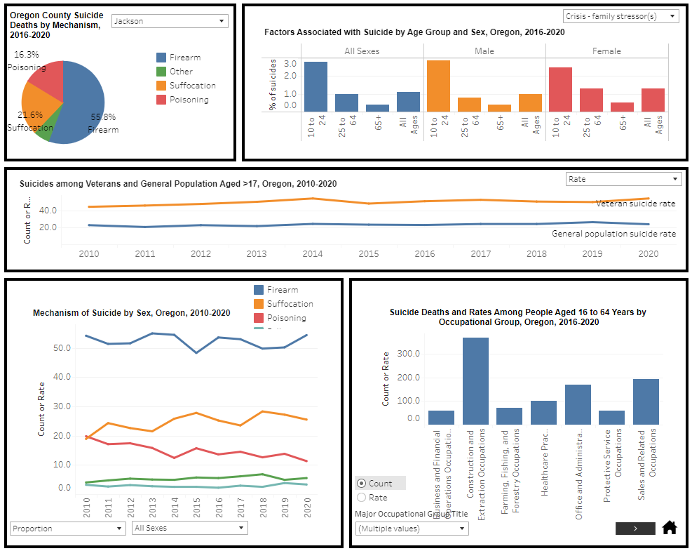
Notes:
Here's a look at what the suicide death data dashboard looks like. There are multiple pages to scroll through – this is a screengrab of page 2. It works best in full screen mode. I do recommend going in and playing around with the data visualizations, because there's a lot of info you can get directly from the dashboards!

Slide 9
Note about Center for Health Statistics Data
OHA’s Vital Statistics, Center for Health Statistics provides death data including violent deaths through review of death certificates.
Information is available by state, county, age, race, ethnicity and sex.
Preliminary death data, including suicide deaths, are updated monthly through the OHA Vital Statistics Death Data Dashboards. Data is finalized 10 to 11 months after the calendar year. For example, data from 2021 will be finalized by November 2022. There is also an Injury Death Dashboard with state and county level data available using finalized data.
CHS data can be requested if the requestor has a valid need for the information, the requestor is authorized to receive the information; and the integrity of the vital record or report ca be assured. Learn more and request data via the OHA Vital Statistics Data Use Request webpage.
Notes:
Taylor
Another data source you may have heard of is the Center for Health Statistics or CHS Data. CHS provides death data through review of death certificates. Because it just looks at death certificate data, CHS data is faster than ORVDRS.
Data is available by state, county, age, race, ethnicity, and sex.
Preliminary death data, including suicide deaths, are updated monthly through the OHA Vital Statistics Death Data Dashboards. Data is finalized 10 to 11 months after the calendar year. For example, data from 2021 will be finalized by November 2022. There is also an Injury Death Dashboard with state and county level data available using finalized data.
If you have a valid need for this data, you can request it through the OHA Vital stats data use request webpage.

Slide 10
OHA Preliminary Mortality Death Dashboard
Always note that this is preliminary data.
Notes:
Taylor
So here's a brief look at the CHS data dashboard. Always note that this is preliminary data only. Data is updated monthly and past counts may change frequently when this happens. It also has deaths tabulated by county of residence, not where the county of death was.

Slide 11
What’s the Difference between CHS and ORVDRS?
The number and rates of deaths will be different form one another because data are collected and defined differently.
Which data are used needs to be based on what questions are to be answered:
For example, if descriptions about deaths are needed, ORVDRS data should be used
If data are needed as soon as possible, then preliminary CHS data may be more helpful
Do not compare across sources
Instead, compare each source to itself over time, How many suicides occurred in 2017 compared to 2018 based on CHS data?
You can use multiple sources of information to describe general trends, Both CHS data and ORVDRS data show an increase in the number of suicides between 2017 and 2018.
Notes:
Taylor
So it's important to note that the number and rate of deaths will be different between the two datasets, because data are collected and defined differently. As a reminder, ORVDRS looks at a number of sources to report on violent deaths; whereas, CHS only looks at death certificates. Each of these sources have strengths and one is not better than the other.
It's important to understand what type of question you're looking to answer to decide which dataset to look at. If needing data as soon as possible, then preliminary CHS data may be most helpful; however, if descriptions about deaths are needed, ORVDRS data should be used.
The most important thing is to not compare data from one source to another. Instead, compare each source to itself over time. You can then look to answer questions like how many suicides occurred in 2017 compared to 2018 based on CHS data? You can however use multiple sources of information to describe general trends. So you could say that both CHS and ORVDRS data show an increase in the number of suicides between 2017 and 2018.
Perhaps add table of differences? Crude rates vs. age-adjusted rates…will we then have to explained crude vs. age-adjusted….

Slide 12
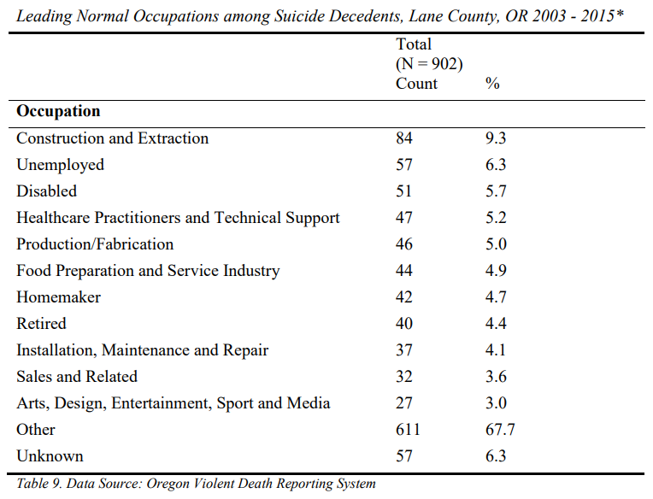
Oregon Violent Death Reporting System (ORVDRS)
ORVDRS data can provide help answer questions like:
What occupation group accounted for the greatest number of suicide deaths?
Suicide in Lane County, 2000-2016: Trends, Risk Factors and Recommendations
Notes:
Taylor
So now that you have some familiarity around the dataset, you may wonder what are some of the questions the data can answer. This is an example from the Suicide in Lane County 2000-2016 Report. As ORVDRS data collects information on occupation, you could look to answer the question what occupation group accounted for the greatest number of suicide deaths?
Here's what Lane County found, from 2003 - 2015 nearly four out of five deaths occurred among people actively participating in the workforce (78.94%) (Table 9). Nearly one in ten deaths by suicide occurred among people employed in the Construction and Extraction trades. Roughly one in twenty deaths occurred among people employed in either Healthcare and Technical Support; Production/Fabrication; Food Preparation and the Service Industry; or Installation, Maintenance and Repair, respectively. It is also Page | 26 September 2018 Lane County Public Health important to note that over one in five decedents (21.06%) were not actively participating in the workforce at the time of their death.

Slide 13
Oregon Violent Death Reporting System (ORVDRS)
ORVDRS data can provide help answer questions like:
How many people who died by suicide had a diagnosed mental illness?
Suicide in Deschutes County 2000-2017: Trends, Risk Factors, and Recommendations
Notes:
Taylor
Another question you could answer is how many people who died by suicide had a diagnosed mental illness? In the Suicide in Deschutes County 2000-2017 Report, they found that 81.6% of people who died by suicide had underlying depression or dysthymia at the time of death, 17.1% of people had bipolar disorder, and 13.2% of decedents had anxiety disorder. This accounts for the top three most common underlying mental health diagnoses. It's important to note that this represents diagnosed mental illness only and therefore may be underreported.
This also then may Inform efforts on how to work with healthcare and training for healthcare professionals in recognizing link between MH diagnosis and suicide risk.

Slide 14
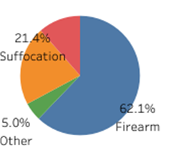
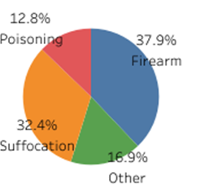
Oregon Violent Death Reporting System (ORVDRS)
ORVDRS data can provide help answer questions like:
What mechanisms are used in deaths by suicide in my county?
Oregon County Suicide Deaths by Mechanism, 2016-2020
All Oregon Counties
Josephine
Multnomah
Oregon Violent Death Reporting System Data Dashboard
Notes:
Taylor
Another piece of information you can gather directly from the online data dashboards is what mechanisms are used in deaths by suicide in my county? Here we see that across Oregon, firearms account for 52.1% of suicides with the second most prevalent means being suffocation at 26%. In Josephine County, firearm deaths account for 62.1% of all suicides while in Multnomah County they account for 37.9% of all suicide deaths.
Consider what data looks like in your county to focus suicide prevention efforts.

Slide 15
Electronic Surveillance System for the Early Notification of Community-Based Epidemics
Emergency departments (ED) and participating urgent care centers (UCCs) share de-identified data with OHA
Data is shared with OHA daily.
Used to monitor activity such as suicide attempts
OHA publishes monthly surveillance reports on suicide and overdose activity.
Local public health and hospital ESSENCE users can get data for their county or service area data. Visit the OHA Accessing Oregon ESSENCE webpage for more information and to apply for access.
Notes:
Meghan
Syndromic surveillance in Oregon (a project called Oregon ESSENCE - Electronic Surveillance System for the Early Notification of Community-Based Epidemics) provides real-time data for public health and hospitals to monitor what is happening in emergency departments across the state before, during and after a public health emergency.
Traditionally, this type of dataset was used to track disease outbreaks (or syndromic outbreaks) in ESSENCE, now we are looking at suicide related visits to ED/UCC to identify spikes. Emergency departments and participating urgent care centers in Oregon share de-identified information on visits to monitor health-related activity, such as suicide attempts and non-fatal overdose. This information is shared with OHA several times a day so that public health officials can alert staff if a higher-than-expected number of visits occur. Approved local public health ESSENCE users can get data daily for their counties.
Been in use since 2018 when algorithm supporting suicide related events verified and has a built in algorithm to detect higher than expected activity.
Approved local public health authority and hospital ESSENCE users can get data daily for their counties.
We send out a monthly suicide report.
Developing public facing dashboard with ESSENCE data which will include data on suicide-related visits by age, sex, race, ethnicity, county, and month/year of occurrence.
Limitations: The data do not have information on factors that may have led the person to suicide, such as untreated depression or life stressors. Not all people in Oregon have access to an ED or UCC and may not utilize them for a variety of reasons. Not all people with suicide ideation or an injury from a suicide attempt need or seek medical assistance which would not be captured in this data.

Slide 16
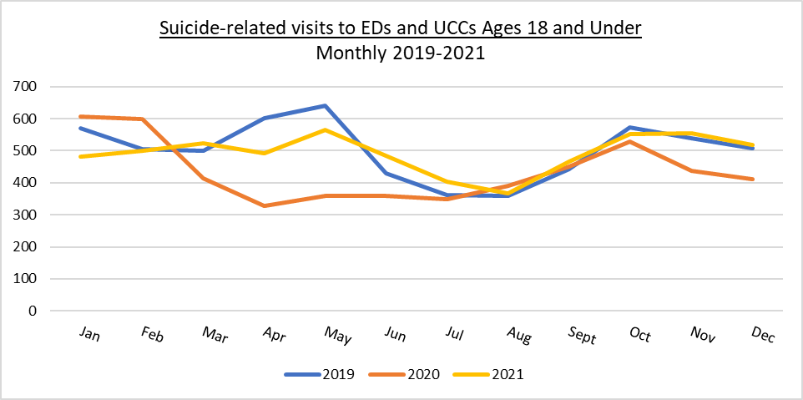
How many suicide-related visits have there been to Emergency Departments and Urgent Care Centers for ages 18 and under?
Total visits: 2021 = 5,904; 2020 = 5,227; and 2019 = 6,016
Source: Oregon Electronic Surveillance System for Early Notification of Community-Based Epidemics (ESSENCE). Available through the OHA Monthly Suicide-Related Data Report
Notes:
Meghan
Question: How many Oregonians ages 18 and under reported to an ED or UCC with suicide-related visit in 2020 vs. 2021? Do we see trends in visits by month?
Realtime data very helpful for tracking clusters. The story of suicide is much broader than deaths. When looking at suicide prevention efforts, knowing who is dying is important, but it may be a very difference picture of who is attempting suicide.
As an inverse to suicide deaths, women are more likely to present to the ED or hospital for a suicide attempt. Recent ESSENCE data shows that women made up 65% of suicide attempt ED and UCC visits compared to men accounting for 35%.
This is a summary of Suicide-related visits to Emergency Depts. and Urgent Care Centers for ages 18 and under.
Suicide-related visits to emergency departments (EDs) and urgent care centers (UCCs) for youth ages 18 and under in 2020 were lower than 2019. There was a decrease in total visits for all health concerns between March and June of 2020 corresponding with the spread of COVID-19. Suicide-related visits to EDs and UCCs for youth aged 18 and under in 2021 are similar to 2019.
We are not making the case that we have proof of less suicide-related attempts or thoughts through this data set. One of the limitations of this data set is that many suicide attempts are not medically serious enough to require medical attention and are not captured in this data set. It also has to be coded as a suicide attempt and this may not been done for a variety of reasons (not primary code, privacy). Also hospital data may under or over-represent certain communities. For example, individuals with lower income are more likely than individuals with higher incomes to use EDs for the care of lower-severity medical problems. As a result, hospital data may over-represent suicide attempts of individuals with lower incomes. This data also does not include psychiatric facilities or Veteran’s Affairs medical facilities since they do not participate in this data system.
Next slide.

Slide 17
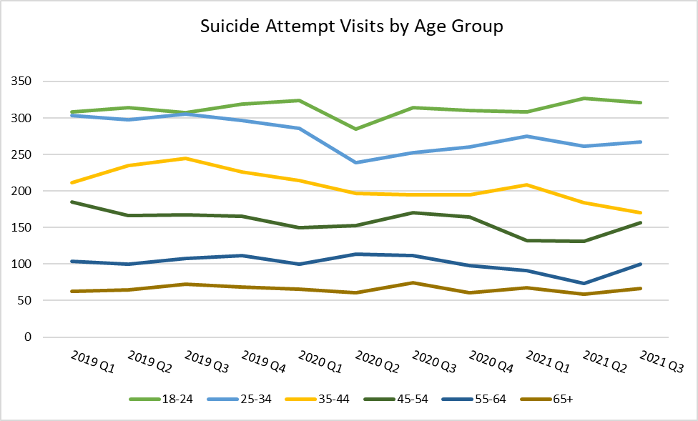
What do suicide attempt visits in Oregon look like based on age?
Count
Source: Oregon ESSENCE
Notes:
Adults ages 18-24 have the highest number of suicide attempt visits, while adults ages 65 and older have the lowest. This chart represents counts and not rate, so it’s not possible to draw an accurate comparison of rates of suicide attempts from this data.

Slide 18
Hospital Discharge Data from Oregon Association of Hospital and Health Systems
Discharge data include hospital and emergency department (ED) information.
Hospitals and EDs report data to the Oregon Association of Hospital and Health Systems (OAHHS) on visits and stays when there is a charge for services.
This information includes diagnosis, medical care received, and demographic information (e.g., age, sex, race, and ethnicity).
Hospital and ED discharge data do not overlap.
If a patient goes to an ED first and then is admitted to the hospital, their information will appear in the hospital discharge data only.
Notes:
Meghan
Limitations: Administrative data sets typically capture population data, but tracking public health trends is not their primary function. For example, administrative data sets do not capture all hospital inpatient visits for suicide attempts due to coding.

Slide 19
Emergency Dept. and Hospital Discharged Data Elements include:
Demographics (age, sex, race/ethnicity, county of residence)
Admission source and type
Mechanism or type of suicide attempt/self-harm (fall, firearm, etc.)
Diagnosis and procedure information (underlying conditions as well)
Chief and additional admitting diagnoses
The condition of the patient at discharge and categories to where a patient discharged (disposition)
Costs (across categories of care) and payers (up to three)
Work related injury or illness
Social determinants using Z codes in ICD-10 (International Classification of Disease)
Notes:
Meghan
Still really understanding how we can use this data source for suicide prevention efforts.
Costs:
- Total ED discharge charges 2018-2021: $65,663,895
- Total Hospitalization discharge charges: $100,929,648
There are three primary categories under the ICD-10 code guidelines for mental health: G, Z, and F. The Z codes (Z00-Z99) provide descriptions for when the symptoms a patient displays do not point to a specific disorder but still warrant treatment.
The Z codes serve as a replacement for V codes in the ICD-10 and are 3-6 characters long. In specific situations such as administrative examinations and aftercare, you can bill them as first-listed codes. You can also use them as secondary codes.
Some of the situations in which Z code are applicable include:
When a person, whether sick or not, receives treatment for a specific purpose, current condition, or to discuss a problem that is not an injury or disease in itself
When something that is not an illness or injury affects a person’s health status
Z codes are important, as they cover a wide range of stress factors that contribute to behavioral health conditions. These include:
Traumatic brain disorder (TBI)
Employment-related problems
Housing challenges
Psychosocial challenges such as unwanted pregnancy and imprisonment
Psychological traumas not classified elsewhere

Slide 20
Hospital Discharge Data from Oregon Association of Hospital and Health Systems
Hospital In-Patient Discharge Data
Hospital discharge data include information for hospital visits that were at least 24 hours long.
It takes six months for data to become available. For example, information about discharges in July 2021 would be available in January 2022.
Notes:
Meghan
This data has been available since 2000 although diagnoses classifications changed in Oct. 2015, so information after this cannot be compared directly to data from earlier years.
Bullet 1: Does not include outpatient and ED visits
Hospitals submit their in-patient hospitalization data to the Oregon Association of Hospital and Health Systems (OAHHS) in a secure manner. An OAHHS vendor cleans and provides data to OHA who does further quality assurance to share internally.
All hospitals in Oregon report quarterly data (only in-patient patients)
Working on making this data available online. Currently provide data to Local Public Health Authorities twice a year. Also included in Youth Suicide Intervention and Prevention Plan annual report by county.

Slide 21
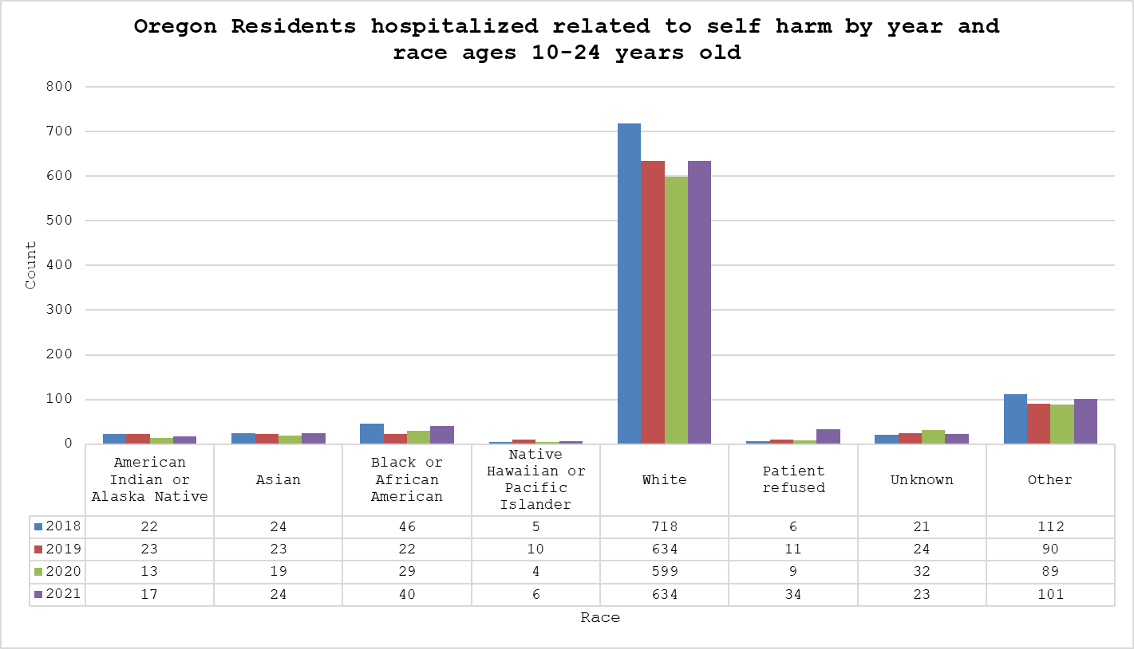
Which communities are hospitalized for suicide/self-harm?
Source: Oregon Association of Hospital and Health Systems (OAHHS)
Notes:
Meghan
Adults ages 18-24 have the highest number of suicide attempt visits, while adults ages 65 and older have the lowest (Figure 8). Figure 8 represents counts and not rate, so it’s not possible to draw an accurate comparison of rates of suicide attempts from this data.
May be interesting to consider this data in your county based on racial make-up of the county to see if groups are distortional represented in the data.

Slide 22
Hospital Discharge Data from Oregon Association of Hospital and Health Systems
Emergency Department (ED) Discharge Data
Include information for ED admissions. This information has been available since 2018.
It takes six months for data to become available. For example, information about discharges in July 2021 would be available in January 2022.
Notes:
This data set has been available since 2018.
Hospitals submit their emergency department only admissions (no patients admitted to in-patient are reported) data to OAHHS in the secure manner. An OAHHS vendors cleans and provides data to the Oregon Health Authority who does further quality assurance to share internally.
Working on making this data available online. Currently provide data to Local Public Health Authorities twice a year.

Slide 23
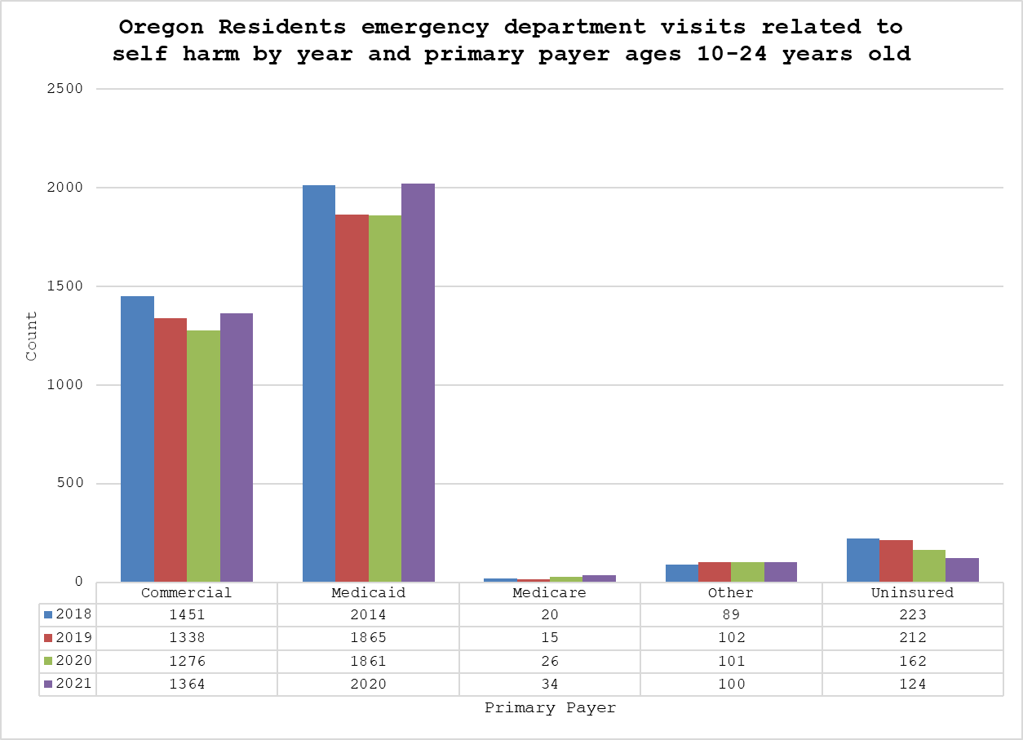
Who is the primary payer for ED visits related to suicide/self-harm for 10-24 years olds?
Source: Oregon Association of Hospital and Health Systems (OAHHS)
Notes:
GET UPDATED DATA FROM DAGAN
Adults ages 18-24 have the highest number of suicide attempt visits, while adults ages 65 and older have the lowest (Figure 8). Figure 8 represents counts and not rate, so it’s not possible to draw an accurate comparison of rates of suicide attempts from this data.

Slide 24
What is the Difference Between ESSENSE and the OAHHS Data Sets?
ESSENCE data describe ED and urgent care visits but do not include information on hospital stays.
Discharge data describe ED visits and hospital stays (only when there is a charge for services) but do not include information on urgent care center visits.
Both ESSENCE and discharge data have ED visit information, but the number of visits reported in ESSENCE will not match the number of visits reported in discharge data since each of these sources collect and report data differently. Data sets cannot be used for comparison purposes.
Instead compare each source to itself over time:
“What was the number of ED visits for suicide attempts from discharge data in 2020 compared to number from discharge data in 2021?
Both sources can be used to describe general trends:
“Both ESSENCE and discharge data show an increase in the number of ED visits for traumatic brain injuries over the last six months.”
Notes:
ESSECE for ED data is more timely and can show ‘outbreaks’ allowing for a more timely response. The hospitalization and ED discharge data has more overall information though and is overall better quality but as a trade-off it is less timely with about a 4 month lag from the closing quarter date. used together can help better inform prevention efforts across the state and communities.

Slide 25
Visualizations of Race and Ethnicity Data
The following graph on race and ethnicity highlights the unequal impact of suicide by race and ethnicity. Health inequities exist due to historic and systemic policies, rooted in white supremacy, that continue to have harmful effects today.
The graphs presented use race and ethnicity as imperfect measures to guide our understanding of how the impact of oppression and discrimination based on race and ethnicity is related in higher rates of suicide by different groups.
Notes:
Shift back to talk some more about some demographics using the Oregon Violent Death Reporting System as an example.
The convergence of identity, politics and inequality provides a unique opportunity to further explore the complexities of race and ethnicity and to improve the way we collect and use data as a tool for social justice. We recognize and acknowledge that the Oregon Violent Death Reporting Systems does not capture the complexity, culture, richness and diversity of Oregonians. Data on race and ethnicity are used to identify health disparities and measure progress towards achieving equity. Historically, the focus has been on having people categorize themselves according to prescribed groups instead of how people self-identify based on their own lived experience. For instance, the federal government defines race and ethnicity as two distinctly separate entities although many may view them as interchangeable and may not distinguish between the two concepts. People who are multiethnic or multiracial are expected to choose, or this care family and friends for someone who has died by suicide, only one that “best” represents who they are, when that may not resonate with them or accurately reflect how they feel.
In population based surveys, certain racial or ethnic groups are often aggregated to allow for more robust numbers for analysis. However, broad racial and ethnic groupings often mask important differences between more granular ethnic groups and do not acknowledge important differences in culture, custom, health care beliefs and practices.
Oppression has also led to social expectations of masculinity, including toxic masculinity that can create stigma which makes asking for help perceived as weak, isolation and increase other risk factors, influencing men.

Slide 26
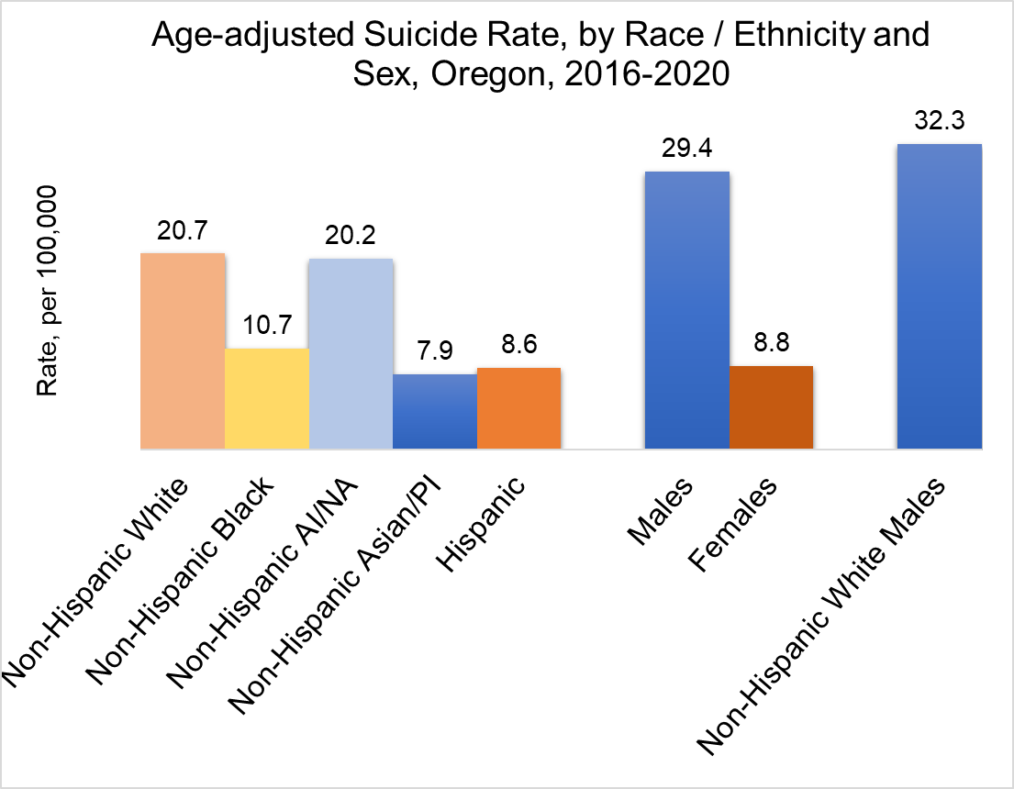
Source: Oregon Violent Death Data Dashboard
Notes:
You can see higher rates for non-Hispanic American Indian and Alaska Native, non-Hispanic White and boys and men.
non-Hispanic AI/NA have the high suicide rate, economics and institutional racism.
Historical disenfranchisement through genocide and institutional racism has resulted in American Indian and Alaska Native peoples experiencing poorer health and socioeconomic outcomes. These social determinants of health intersect to create a situation that is detrimental to the physical and mental health of Indian communities. Cultural disconnection, alienation and pressure to assimilate all contribute to higher rates of suicide among American Indians and Alaska Natives.
Oregon Demographics (2021):
Population: 4.2 million
Non-Hispanic white: 86.7%
Non-Hispanic black: 2.2%
Non-Hispanic American Indian and Native American: 1.8%
Non-Hispanic Asian/Pacific Islander: 5.4%
Hispanic: 13.4%

Slide 27
Age-Adjusted Suicide Rates by Sex, Oregon, 2016-2020
What is called “sex” in Oregon Violent Death Reporting System refers to the person’s gender identify at the time of their death.
There is a separate variable for noting if a decedent was transgender, and a person can be identified as “male” or female” and also “transgender”.
This dataset does not allow for the identification of non-binary, gender nonconforming or other identities.
OHA is not able to evaluate transgender suicide rates through this data set. Other state and national evidence tells us that transgender, non-binary and gender non-conforming people are more likely than cisgender people to attempt and to die by suicide.
Source: Oregon Violent Death Data Dashboards
Notes:
This slide is an Oregon-specific comparison between aged 10-17, in blue, and those 18-24 years old, in orange, by sex. Boys and men
Gender identity is how a person self-identifies as a particular gender, regardless of biological sex characteristics.
What is called “sex” in Oregon Violent Death Reporting System refers to the individual’s gender identity at the time of their death, and it includes transgender identities (people whose gender identity does not correspond to that assigned to them at birth). There is a separate variable for noting if an individual was transgender, and a person can be identified as “male” or “female” and also “transgender. This data point was added to the data system in 2013. Transgender suicide deaths are not separated out in these visualizations, due to the small numbers. We recognize that this is a limitation in the dataset and does not allow for identification of people who identify as non-binary or another identity. There is likely an undercount on gender identity data in this data system due to data collection issues as well as relying on family and friends to provide an individuals gender identify. 73 people who died by suicide (1.7 % of total suicides) were identified as LGBTQ in NVDRS from 2016 to 2020. Among them, 42 (about 1% of total suicides) were designated as transgender.
We are not able to evaluate transgender suicide rates due to small numbers; however, national evidence tells us that transgender women, men, girls, boys, and non-binary people are more likely than cisgender people to attempt and to die by suicide. This is not due to how they identify, rather due to issues such as transphobia, acceptance from their families, trauma of experiencing rejection, and not having access to healthcare that supports their ability to live their authentic lives through gender-affirming healthcare.
We can look to the Student Health Survey data for insight. Data has shown students that described themselves as transgender or gender nonconforming report higher significantly higher levels of having seriously considered suicide or attempted suicide.
Oregon Demographics (2021):
Population: 4.2 million
Non-Hispanic white: 86.7%
Non-Hispanic black: 2.2%
Non-Hispanic American Indian and Native American: 1.8%
Non-Hispanic Asian/Pacific Islander: 5.4%
Hispanic: 13.4%

Slide 28
Note on Sexual Orientation Data
Sexual orientation data is collected within the Oregon Violent Death Reporting System (ORVDRS). Response options include straight/heterosexual, gay, lesbian, bisexual, unspecified sexual minority, and unknow.
This dataset does not allow for the identification of other sexual orientation identities.
OHA is not able to evaluate suicide rates for this population through this data set. Other state and national evidence tells us that people identifying as not straight (including lesbian, gay, bisexual, asexual, queer, fluid, pansexual, questioning) are more likely to attempt and die by suicide than straight people.
This is not due to how they identify, rather due to issues including homophobia/biphobia/discrimination, acceptance from their family, trauma of experiencing rejection and not having access to healthcare that supports their ability to live their authentic lives.
Notes:
A person’s sexual orientation is the gender, or genders, to which a person is emotionally, romantically, and sexually attracted.
There is a lack of standardized questionnaires and investigations on deaths in Oregon and nationally creates a challenge for collected LGBTQIA2S+ status among people who died by suicide. Relying on family and close contacts for this data can be challenging if the individual’s sexual orientation was not accepted or known by these individuals, esp. youth. Sexual orientation is likely underreported. Between 2015 and 2019, 5 youth were identified as gay, lesbian, bisexual, unspecified sexual minority.
We can look to the Student Health Survey data for insight. Data has shown students that identify as not straight (including lesbian, gay, bisexual, something else (ex: asexual, queer, fluid, pansexual) or don’t know/not sure) reported higher levels of having seriously considered suicide or attempted suicide.

Slide 29
This is only part of the story of suicide…
Notes:
If you are working on community SP efforts or serve on a coalition, do you have your CCO, hospital, local public health authority and local mental health authority represented? What data do they have access to inform your work?

Slide 30
This is only part of the story of suicide…
Notes:
Safe states graphic: How health, social & community connection, economic stability, housing, education and behavioral health come together to effect mental health and risk of suicide.

Slide 31
This is only part of the story of suicide...
Notes:
Need to recognize the limitations of these data stories and who are and are not represented in this work. “Data are just summaries of thousands of stories – tell a few of those stories to help make the data meaningful.

Slide 32
Additional Learning and Resources
Suicide Prevention Resource Center
Locating and Understanding Data for Suicide Prevention Training
NEW: This web toolkit provide step-by-step information and how-to-tools for comprehensive suicide prevention. Includes Data Element: How to Use Data To Guide Action and Improve Efforts including:
Accessing systems data for planning
Gathering information on community context
Using data to access progress and make changes
Notes:
Need to recognize the limitations of these data stories and who are and are not represented in this work. “Data are just summaries of thousands of stories – tell a few of those stories to help make the data meaningful.

Slide 33
YouthLine
1-877-968-8491
(text teen2teen at 839863)
Text OREGON to 741741
Resources
Sign up for the OHA Suicide Prevention Network: http://listsmart.osl.state.or.us/mailman/listinfo/yspnetwork
Oregon Violent Death Data Dashboards
OHA Student Health Survey ***New SHS Dashboard***
OHA Monthly Suicide-Related Data Report
Oregon ESSENCE (syndromic surveillance)
2021-2025 Youth Suicide Intervention and Prevention Plan and Youth Suicide Intervention and Prevention Plan 2020 Annual Report (includes youth suicide data)
Oregon Veterans Behavioral Health Services Improvement Study
OHA Injury and Violence Prevention Data Glossary
Communities of Color Investing In Culturally and Linguistically Responsive Behavioral Health In Oregon Report
Oregon LGBTQ+ Older Adult Survey
Meghan Crane, MPH
Pronouns: she/her/hers
Zero Suicide in Health Systems Coordinator
Public Health Division
Injury and Violence Prevention Program
p: 971-271-2025
e: meghan.crane@dhsoha.state.or.us
Taylor Chambers, MPH
Pronouns: she/her/hers
Public Health Suicide Prevention Coordinator
Public Health Division
Injury and Violence Prevention Program
p: 503-467-6927
e: taylor.l.chambers@dhsoha.state.or.us

Slide 34
Hope is that thing inside us that insists, despite all the evidence to the contrary, that something better awaits us if we have the courage to reach for it and to work it and to fight for it. Barack Obama
Notes:
This work can be hard. Requires persistent and looking at data that can be challenging to live in day in and day out. What is the hope that keeps you able to do this work?

